Slide 1

Becoming a Doctor
6 March 2025

Slide 2

Welcome!
Two quick questions

Slide 3


How To Use Webinar Software
Feel free to ask questions at any time!

Slide 4
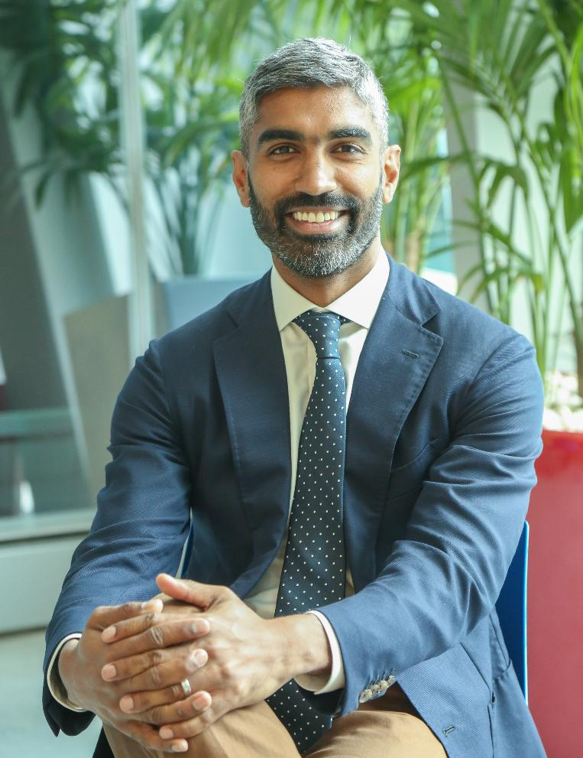
Dr Ray Boyapati
MBBS (Hons I), MD, FRACP, FGESA

Slide 5
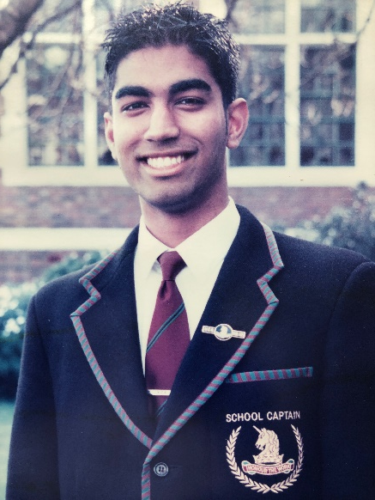










MBBS (Hons I)
100th Percentile
Doctorate
ATAR
99.9
FRACP Medal
MHS School Captain
Gastro-enterologist
Accepted into
All Medical Schools
Dr Ray Boyapati
MBBS (Hons I), MD,
FRACP, FGESA
Monash University
Scholarship to Study Medicine
Taught Tens of Thousands of Students

Slide 6
Plan for this webinar
01
Medicine as a career
02
Medical entrance – Practical Advice
03
Free Resources & How we can Help
04
Q & A

Slide 7


Medicine as a Career

Slide 8
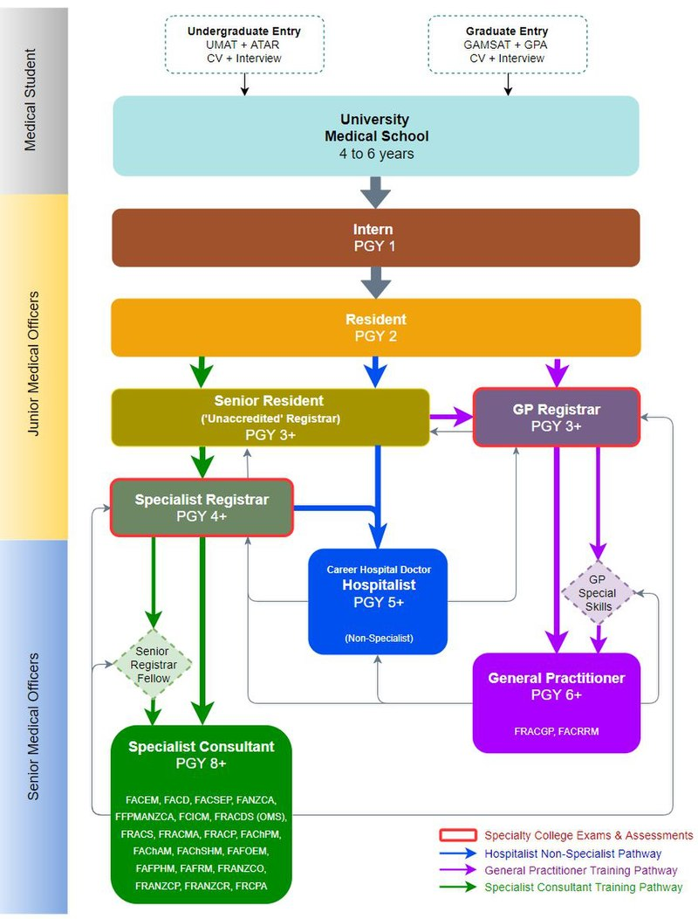
UCAT + ATAR + Interview
The Journey

Slide 9

Advantages of Medicine
Work with people
Interesting
Challenging
Satisfying, rewarding
Diversity of careers
Contribute to advances in knowledge
Flexibility in working hours
Job security, self-employment
Trusted/valued profession

Slide 10

Disadvantages of Medicine
Length and cost of study
Shift work
Workload
Stress
Dealing with sick people
Legal liability
Bureaucratic regulations
Lack of resources
Balance of work / personal life

Slide 11
Specialties
Physician | Surgeon | Other
General Physician Gastroenterologist Cardiologist Respiratory Physician Renal Physician Endocrinologist Oncologist Neurologist Rheumatologist Immunologist Haematologist Infectious Diseases Geriatrician Dermatologist | General Surgeon Maxillo-Facial Surgeon Cardiothoracics Orthopaedics Plastics and Reconstructive Surgery Neurosurgeon ENT Surgeon Otolaryngologist Paediatric Surgeon Vascular Surgeon Urologist Transplant Surgeon Trauma Surgeon Colorectal Surgeon | General Practitioner Emergency Specialist Intensive Care Anaesthetist Obstetrician Gynaecologist Neonatal Physician Psychiatrist Ophthalmologist Pathologist Geneticist Radiologist Allergy Specialist Medical Administrator Rehabilitation

Slide 12

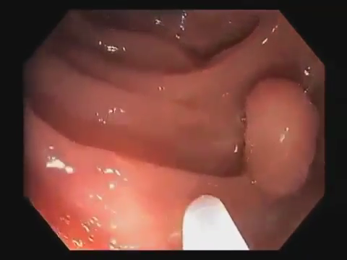
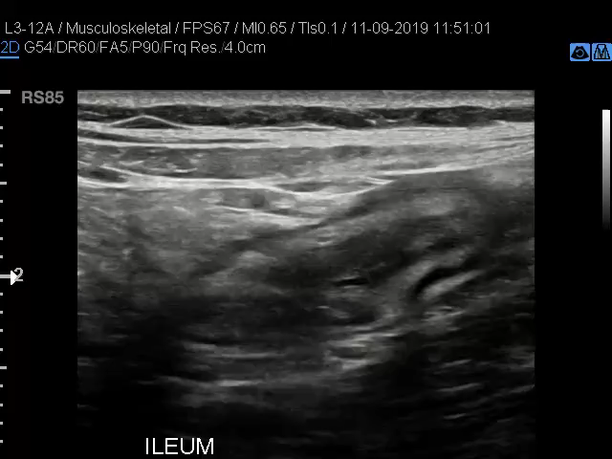
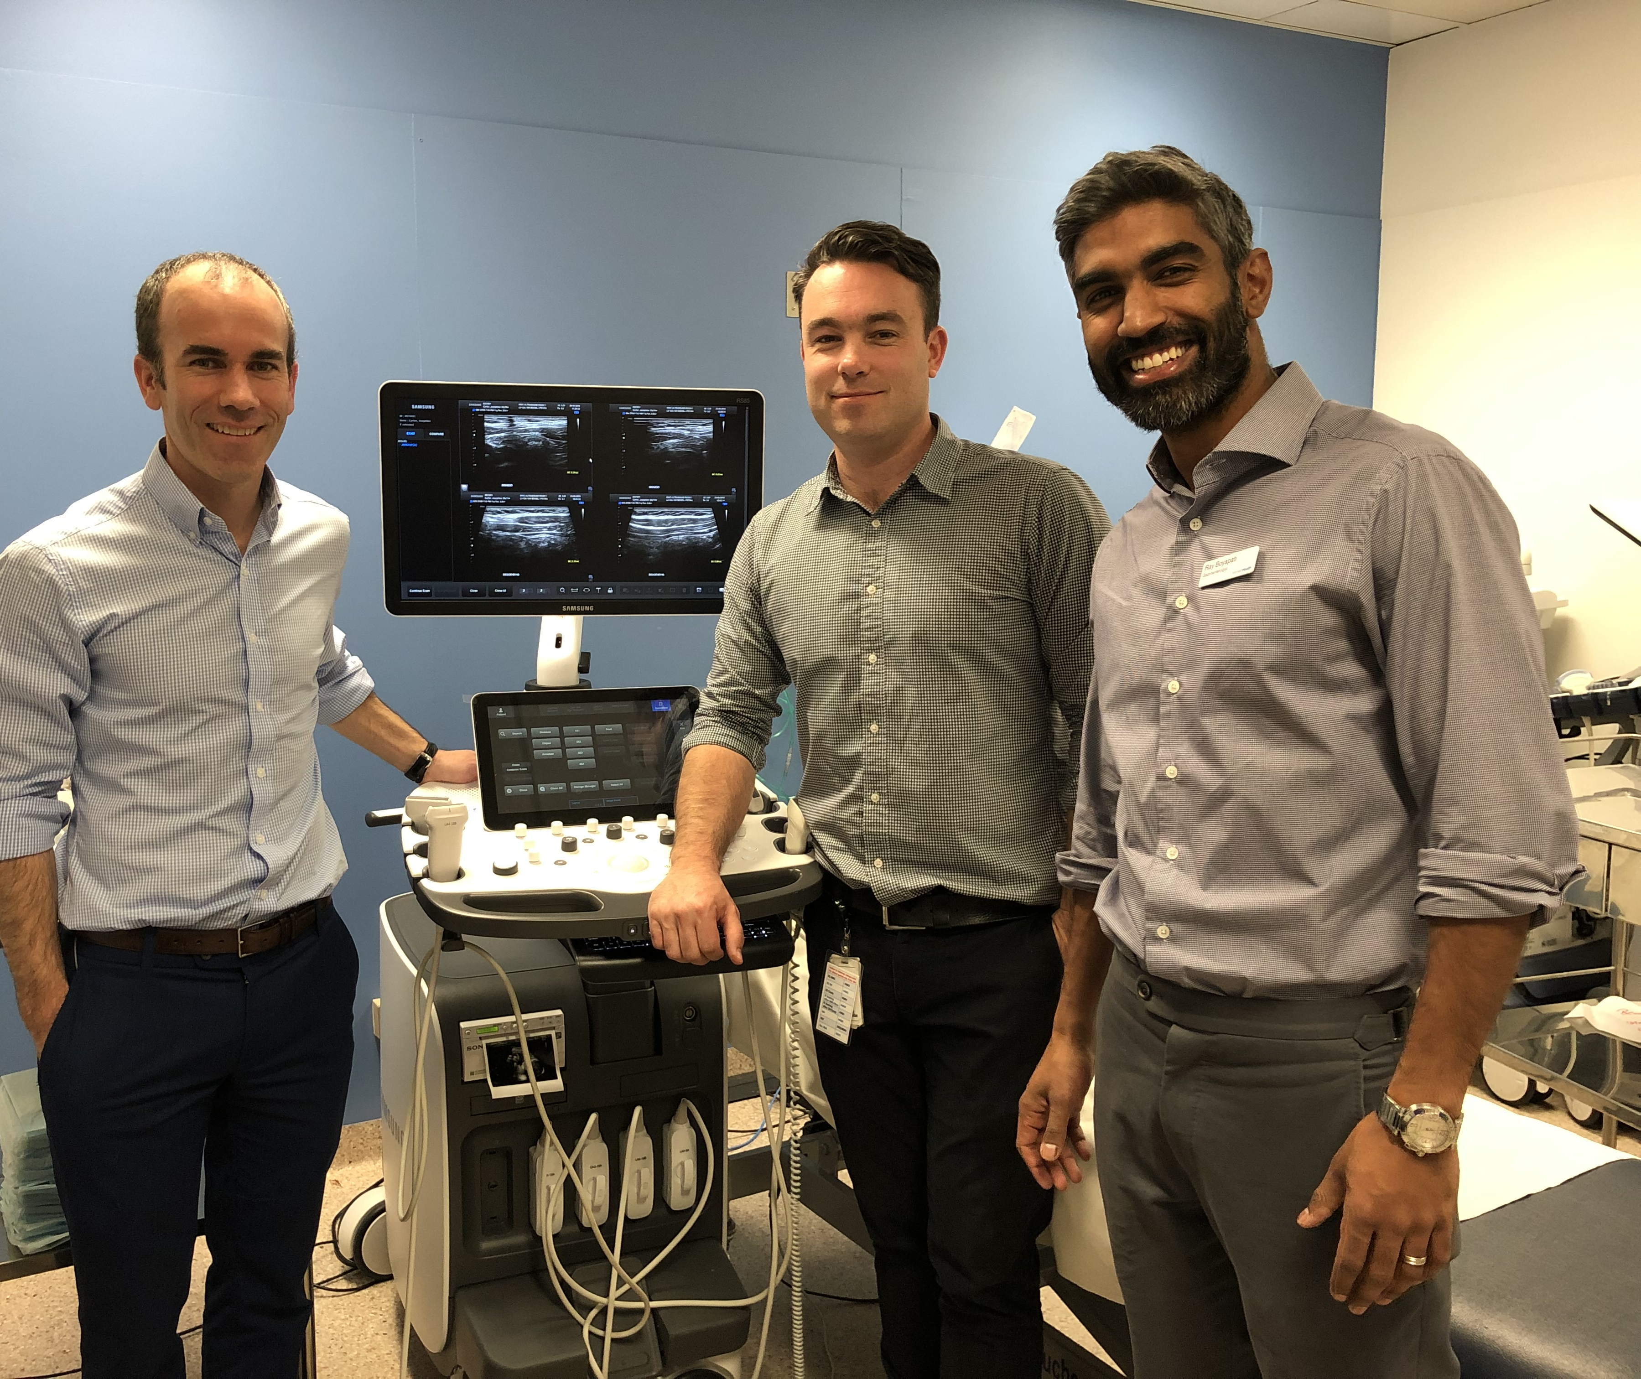

Specialties - Gastroenterology

Slide 13
Medical Entrance
Practical Advice

Slide 14
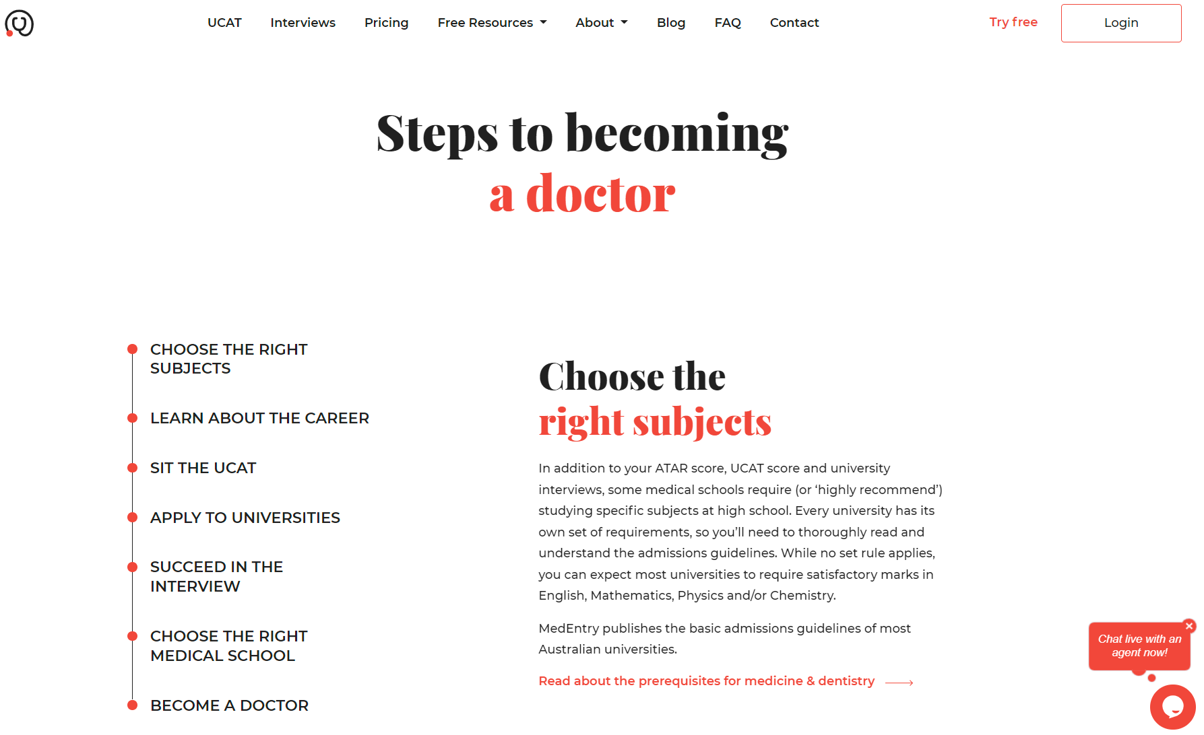
The Steps to Get Into Medicine
www.medentry.edu.au

Slide 15



Pathways into Medicine
Direct
1
Undergrad
Medicine
UCAT
ATAR
Interview
Monash, UNSW, Newcastle/UNE, WSU/CSU, Adelaide, Curtin, UTas, Bond*, JCU*
*No UCAT
School Leaver
Entry
Guaranteed/
Provisional
2
Undergraduate Degree
Postgrad
Medicine
Gap Year
ATAR +/-
UCAT +/-Interview
UQ, UWA, Flinders, Notre Dame , UMelb*, USyd*, Griffith*
Year 12
Non School Leaver Entry
Non-Standard
Entry
Undergrad
Medicine
* No UCAT
** From own uni
*** From own uni or grads from anywhere
3
ATAR/GPA
UCAT
Interview
UNSW, WSU/CSU, Newcastle/UNE, JCU*
Adelaide**, Utas**, Curtin***
Undergraduate
Degree
4
Graduate Entry
Postgrad
Medicine
* Monash grad med no GAMSAT but undergrad has to be one of a few specified Monash courses
GAMSAT*
GPA
Interview
UQ, Griffith, Umelb, Deakin, Notre Dame (Syd, Freo), UWA, ANU, Wollongong, Macquarie

Slide 16
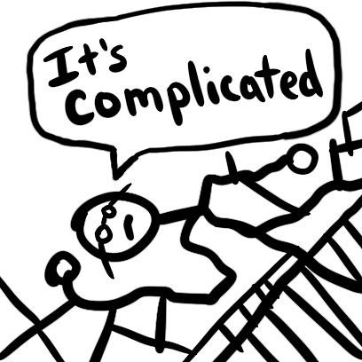

Slide 17
Practical Advice
1. Students should consider applying everywhere including interstate
2. If students don’t “get in” from high school, there are many other pathways
3. It’s a continuously changing and complex area

Slide 18




Requirements for Medicine – Undergraduate Entry
+
+
→
1/3 ATAR
1/3 interview
Academic Grades
UCAT
Interview
Medicine
1/3
UCAT
Prerequisite Subjects

Slide 19
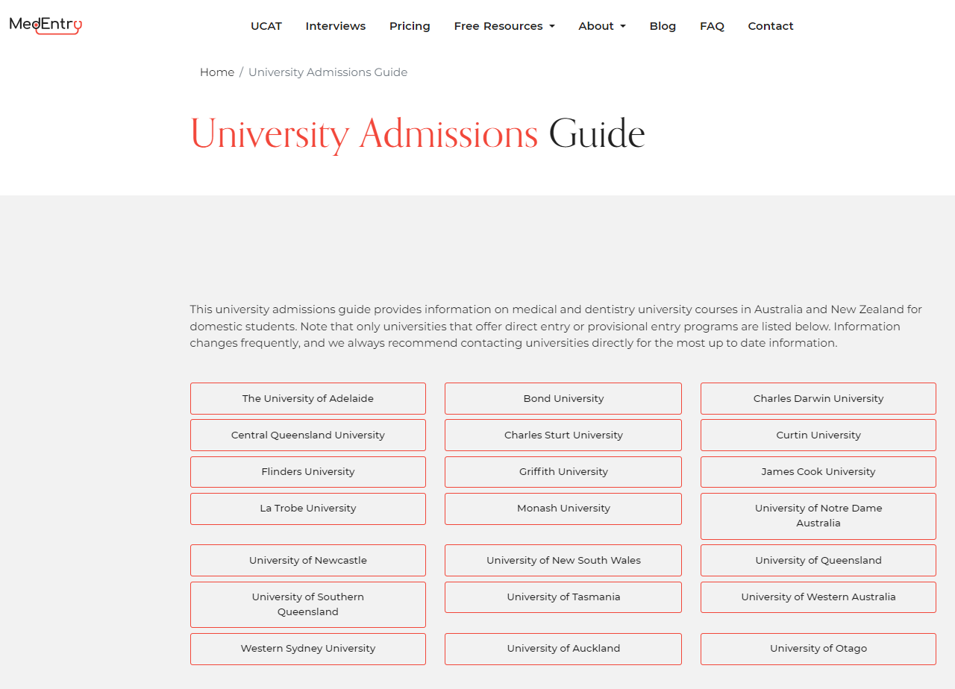
Academic Component
www.medentry.edu.au

Slide 20

Academic Component
BUSTED
Year 12
Common Myth
Have to do science subjects to enter medicine
Common Myth
Have to get extremely high ATAR scores to enter medicine

Slide 21

ATAR
The Process

Slide 22

The Process
Swim
Run
Cycle
ATAR
UCAT
Interviews

Slide 23
+
+
→
1/3 ATAR
1/3 interview
Academic Grades
UCAT
Interview
Medicine
1/3
UCAT
Prerequisite Subjects

Slide 24
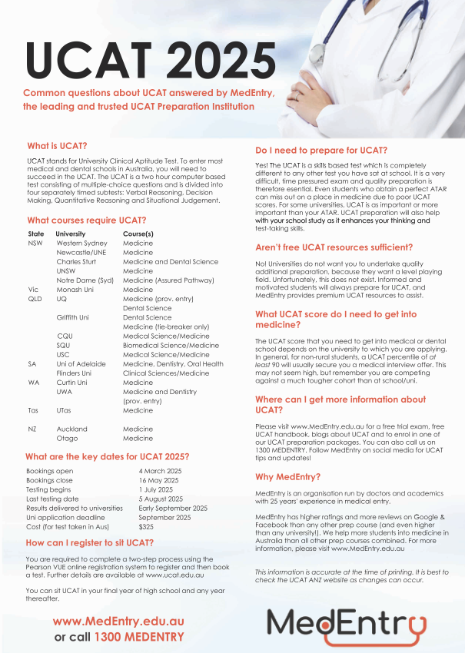
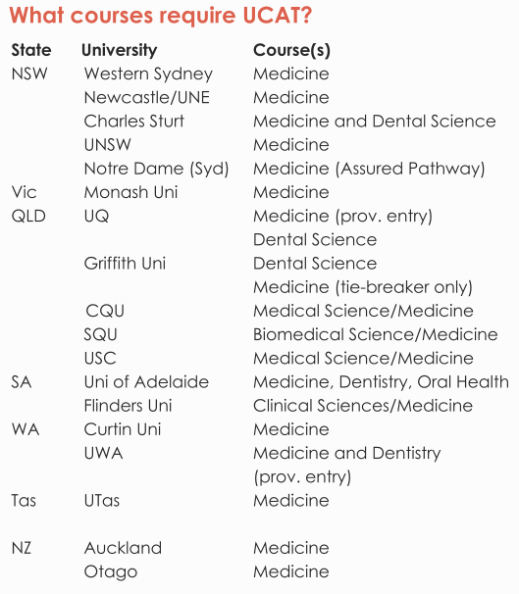
Who needs to sit the UCAT?

Slide 25
Common UCAT Myths
“The UCAT is not that important”
BUSTED
“You can only do UCAT in the final year of high school”
“You can only do the UCAT once”
“You cannot train for the UCAT / only requires a few weeks of training”

Slide 26
Scoring
What is a ‘good’ / high score?

Slide 27







What are the changes to UCAT?
UCAT
Verbal Reasoning
Decision Making
Quantitative Reasoning
Abstract Reasoning
Situational Judgement
1 minute
6 minutes
6 questions
1 minute

Slide 28


Implications of the Change
VR
DM
QR
AR
“Grinding/Spamming Questions”
“Focus on QR & AR, because they scale higher”
Past
“VR takes too long to change, ignore and focus on the others”
VR & DM must now be a major focus
Now
1/3
1/3
1/3
Those who start early will be even more rewarded
Ensure you pick a UCAT provider who is right on top of this

Slide 29

Scoring
2025 – what will be a good score?
50th percentile estimate
1900
90th percentile estimate
2250

Slide 30
Requirements for Medicine – Undergraduate Entry
+
+
→
1/3 ATAR
1/3 interview
Academic Grades
UCAT
Interview
Medicine
1/3
UCAT
Prerequisite Subjects

Slide 31
Importance of Interviews
At many universities, once you get to the interview stage, it becomes the most important factor for medical entry

Slide 32
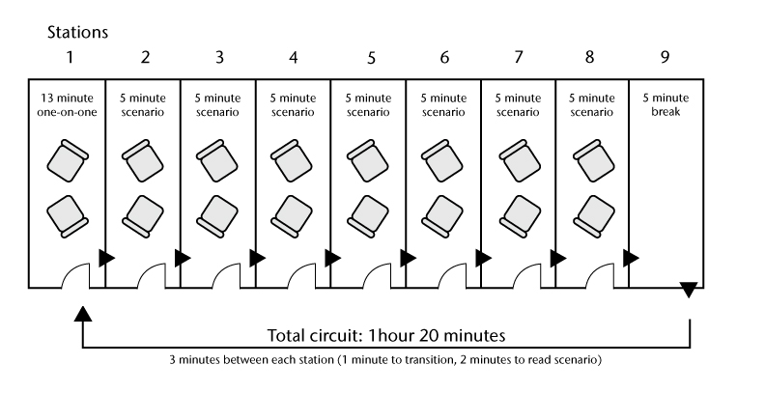
MMIs

Slide 33
Timeline
UCAT Bookings Open
UCAT Results to Unis
Y 12 Results
1st Round Uni Offers
Feb-May
July
Early September
Oct-Dec
Mid Dec
Nov/Dec/Jan
Mid Jan
Late Jan/Feb
Sit UCAT
UCAT Results
Interview offers
Interviews
2nd/3rd Round Offers

Slide 34
How MedEntry Can Help

Slide 35

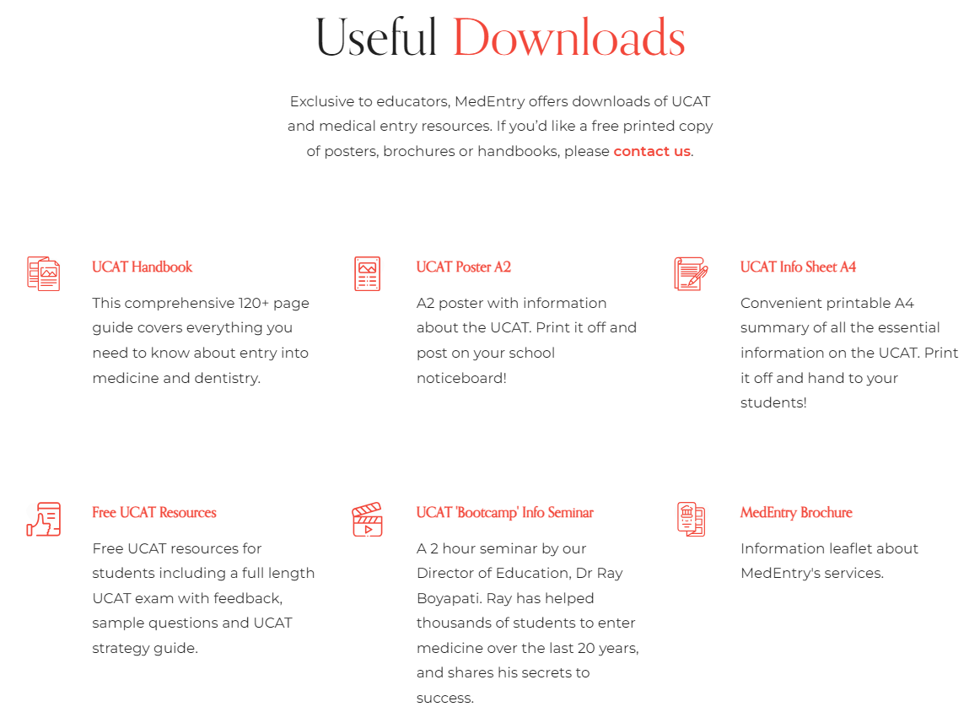
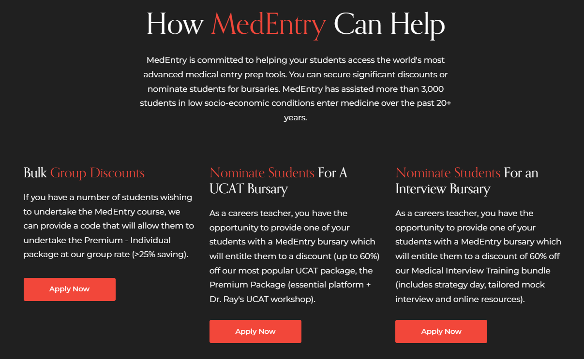
Free Getting into Medicine Help
https://www.medentry.edu.au/teachers

Slide 36

Free Webinars
https://www.medentry.edu.au/resources/medical-entry-webinars

Slide 37

Which UCAT & Interview Prep Provider?
Who runs the organisation?
What is their teaching/business model?
Have they got a track record of success?
How are their public reviews?
*Late bookings 31 May ($85 extra)
*Final late bookings 5 June ($185 extra)

Slide 38


Slide 39
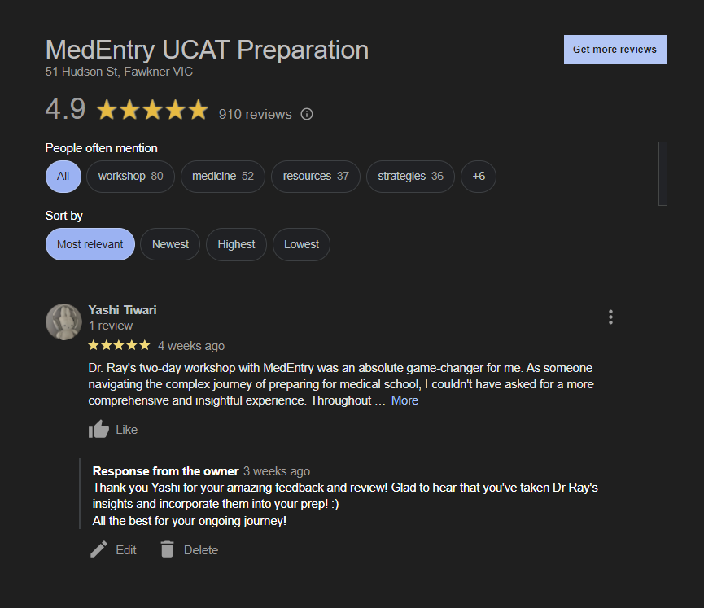


Slide 40
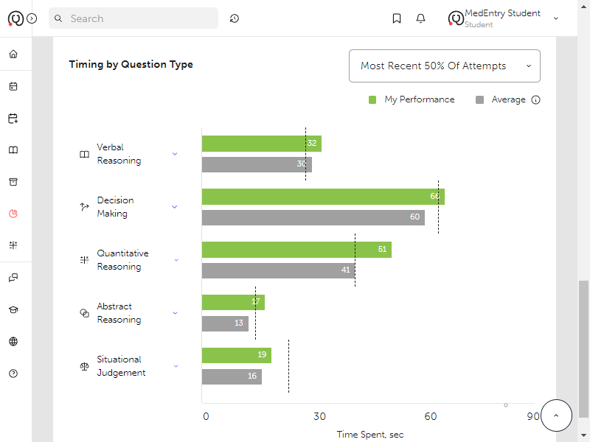
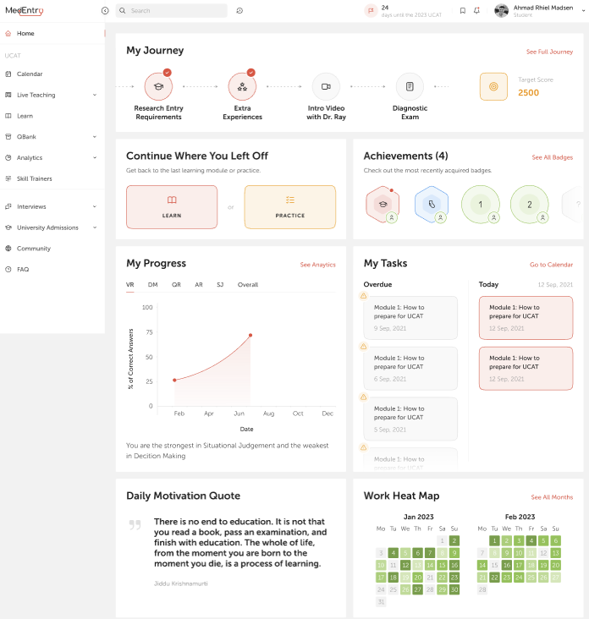
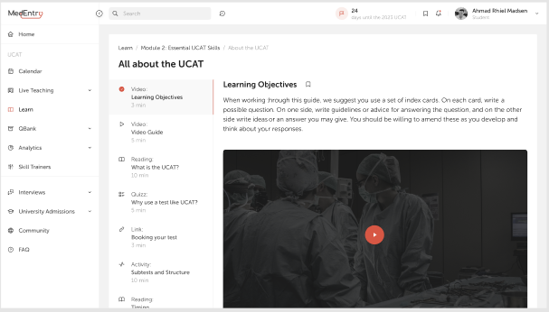
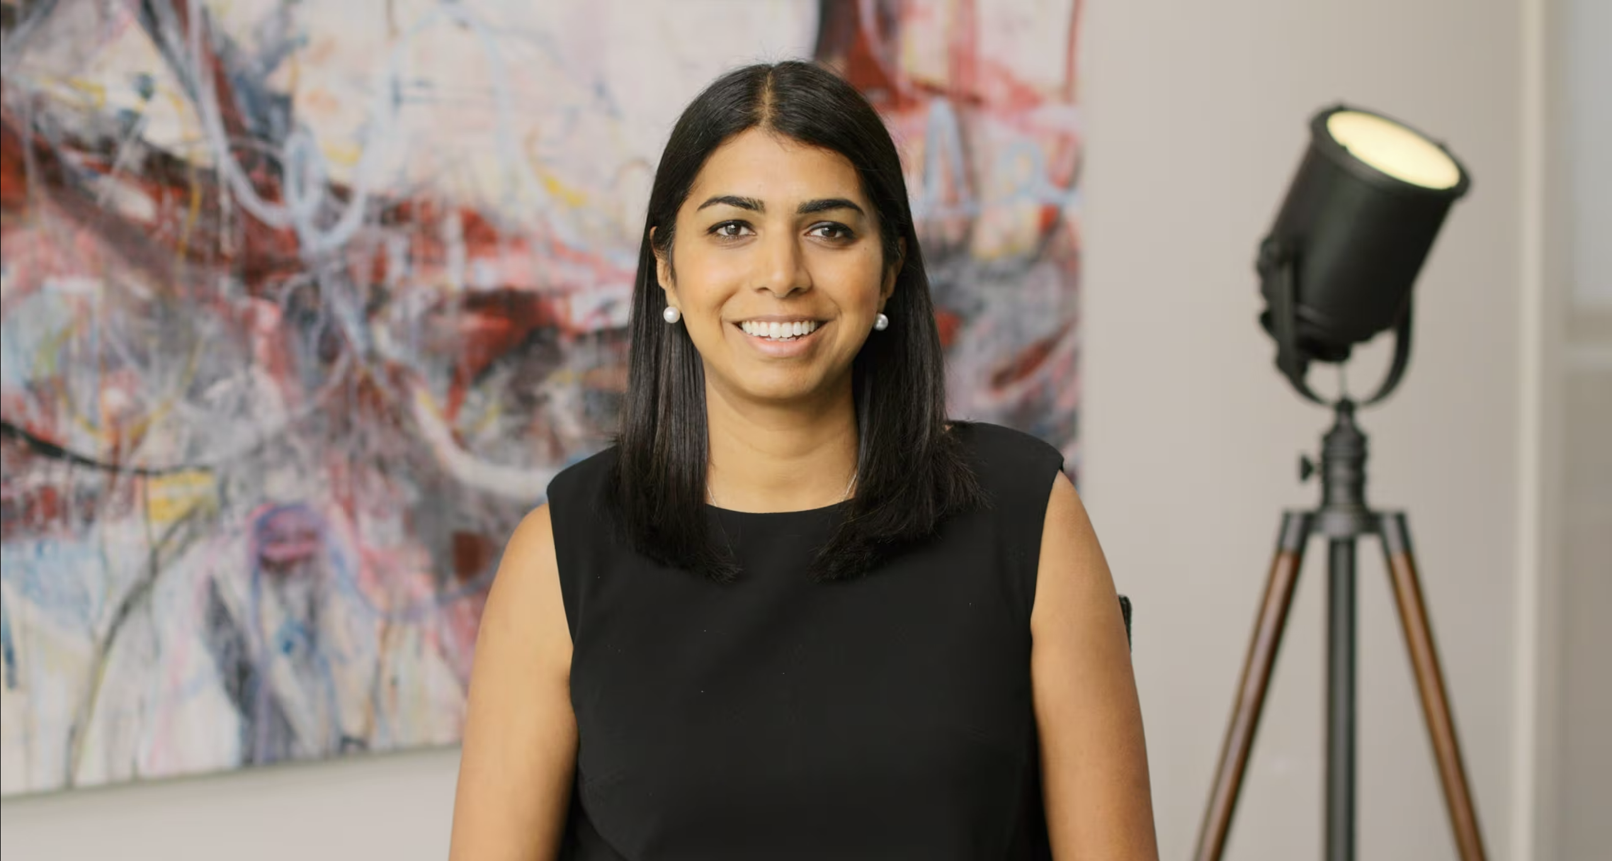
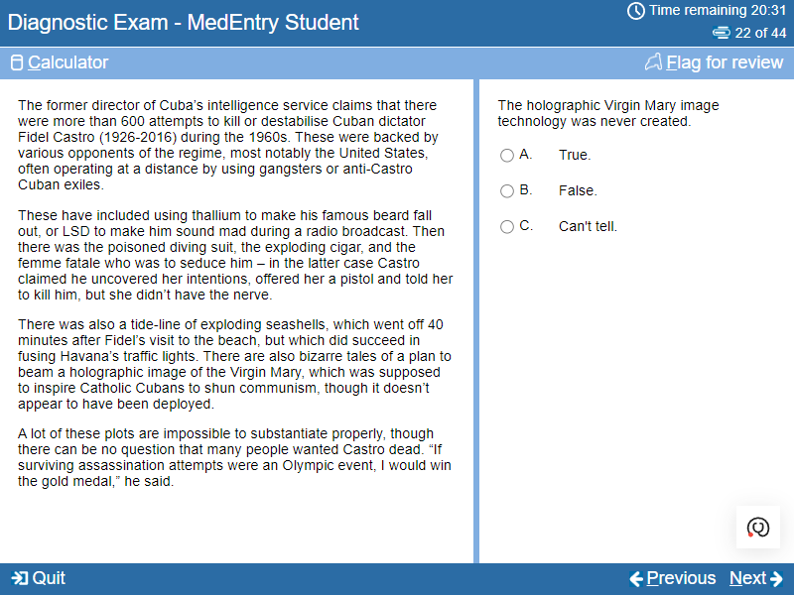
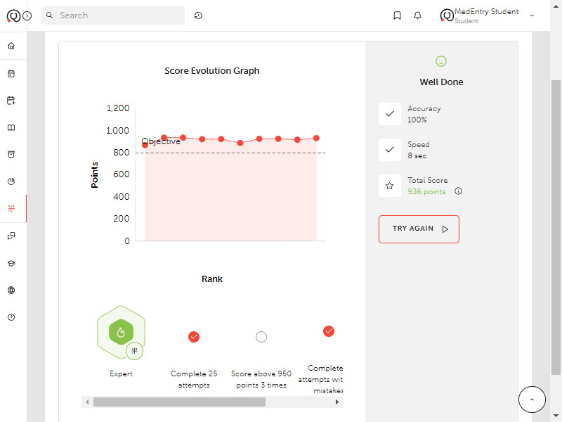
Online Learning Platform

Slide 41
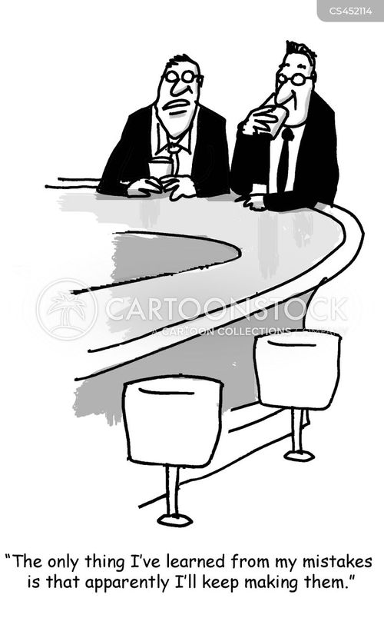

More than just a “Question Bank”

Slide 42
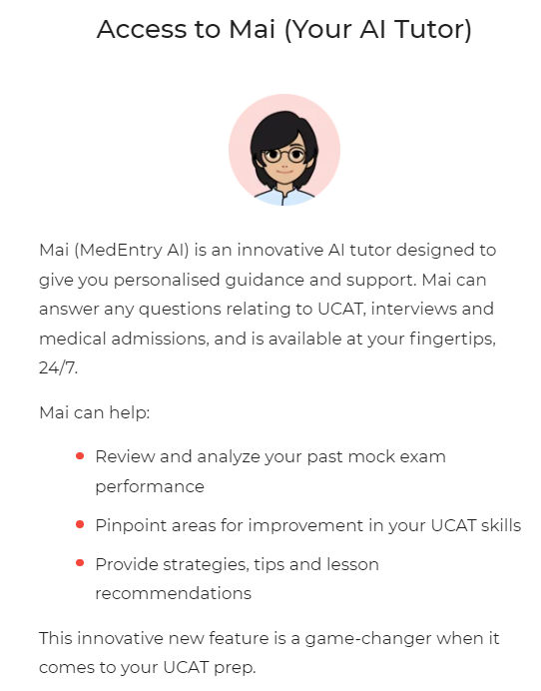
More than just a “Question Bank”
MedEntry AI
Error logging
Skills Trainers
Complete video curriculum
Detailed feedback
In-Built Learning Journal

Slide 43
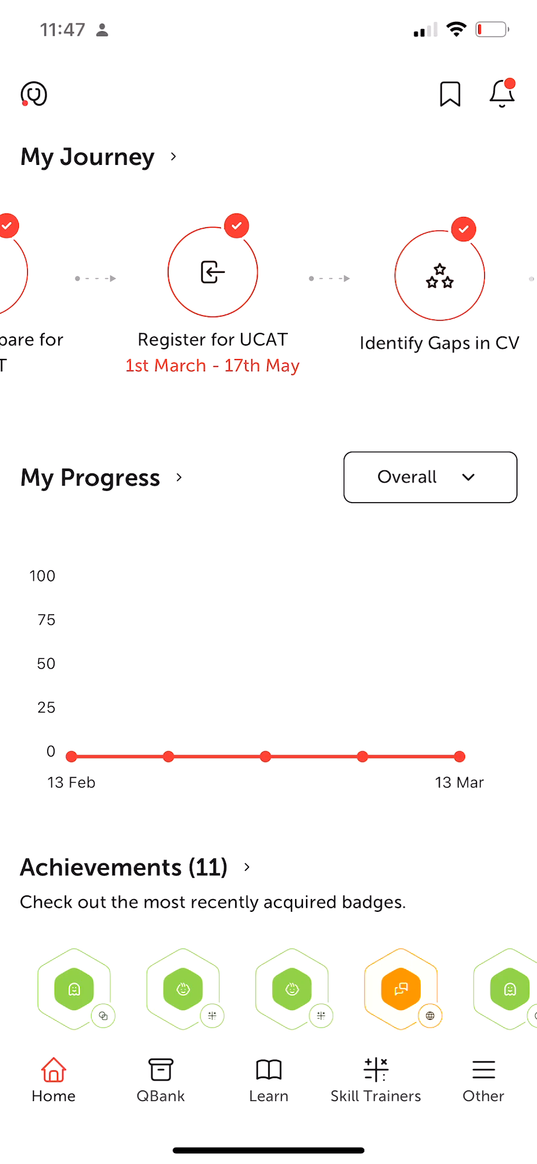
State of the art mobile App

Slide 44
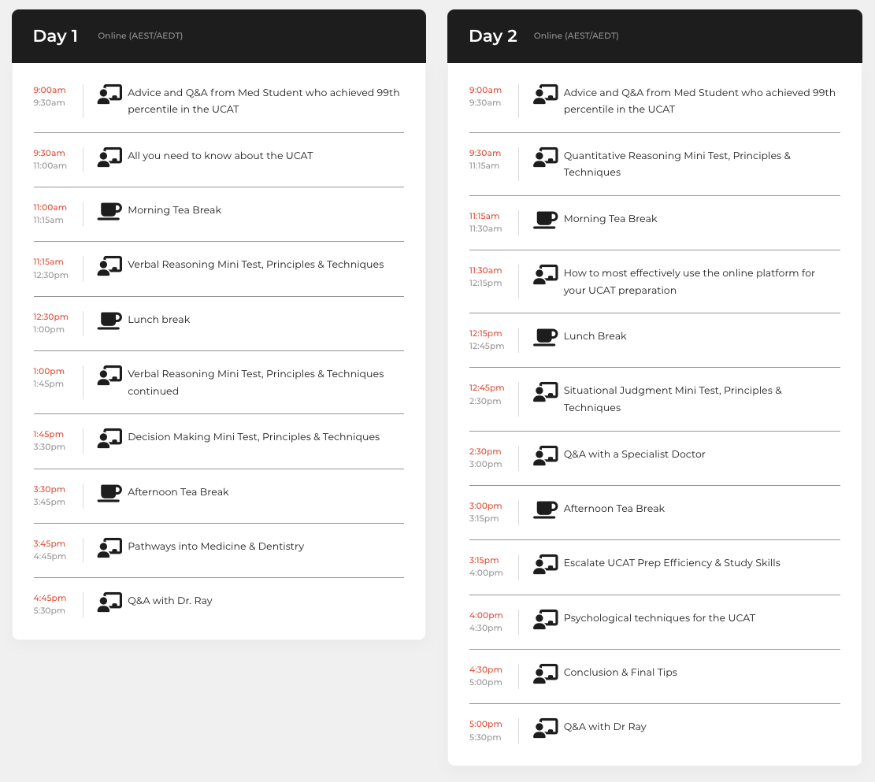
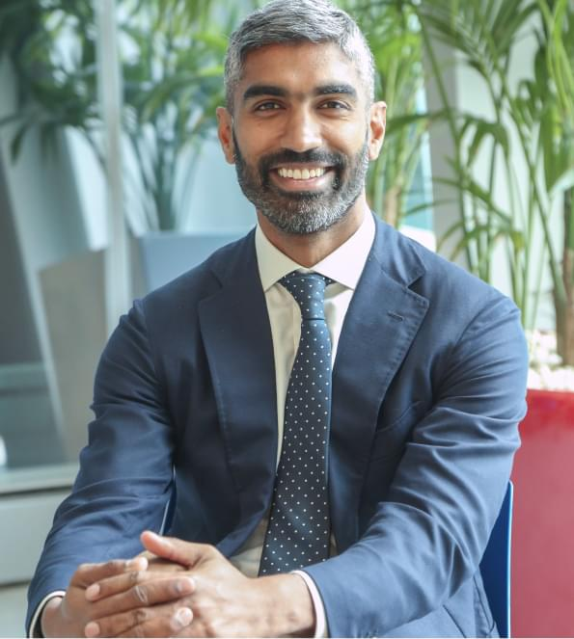
2 Day Workshops
with Dr Ray

Slide 45
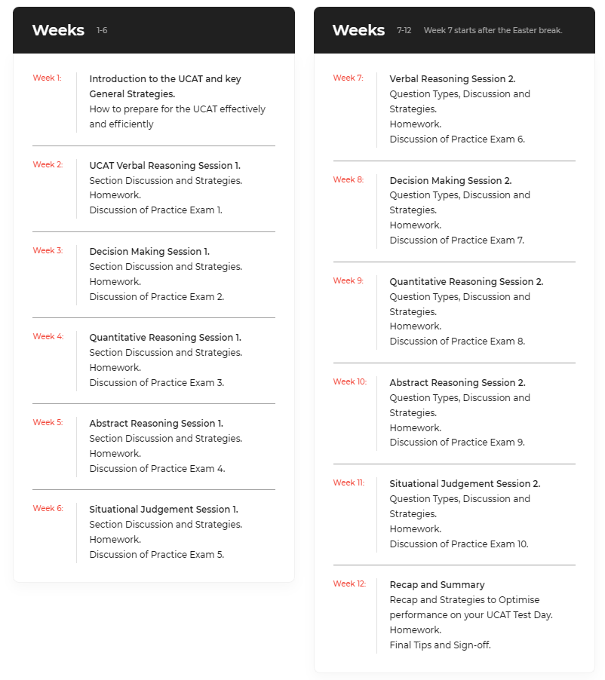
Weekly UCAT Training
or 1-on-1 training

Slide 46

Medical Interview Training

Slide 47
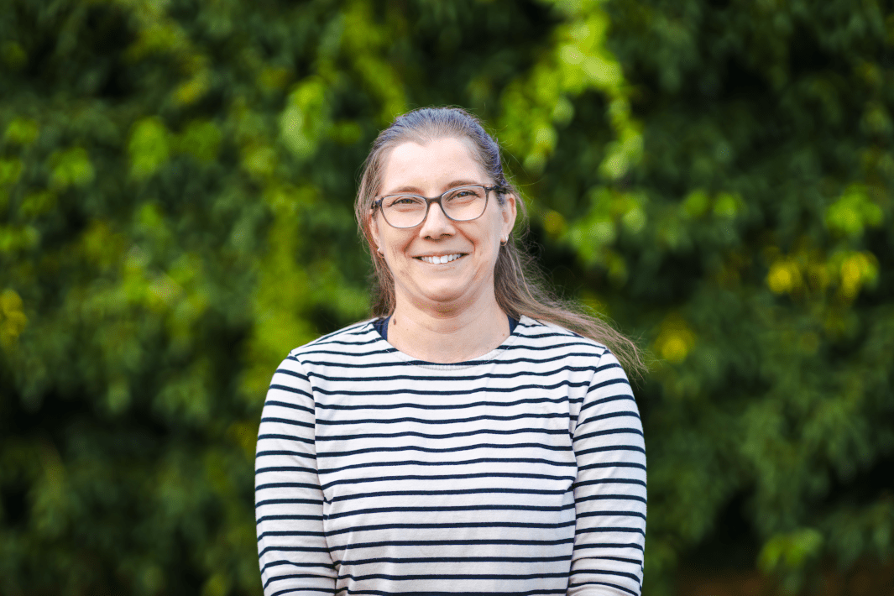

Questions About Preparation?
Feel free to contact Alicia or Sylvie in the office
(03) 9359 9960 or
1300 MEDENTRY
More information & enrol via
www.medentry.edu.au

Slide 48
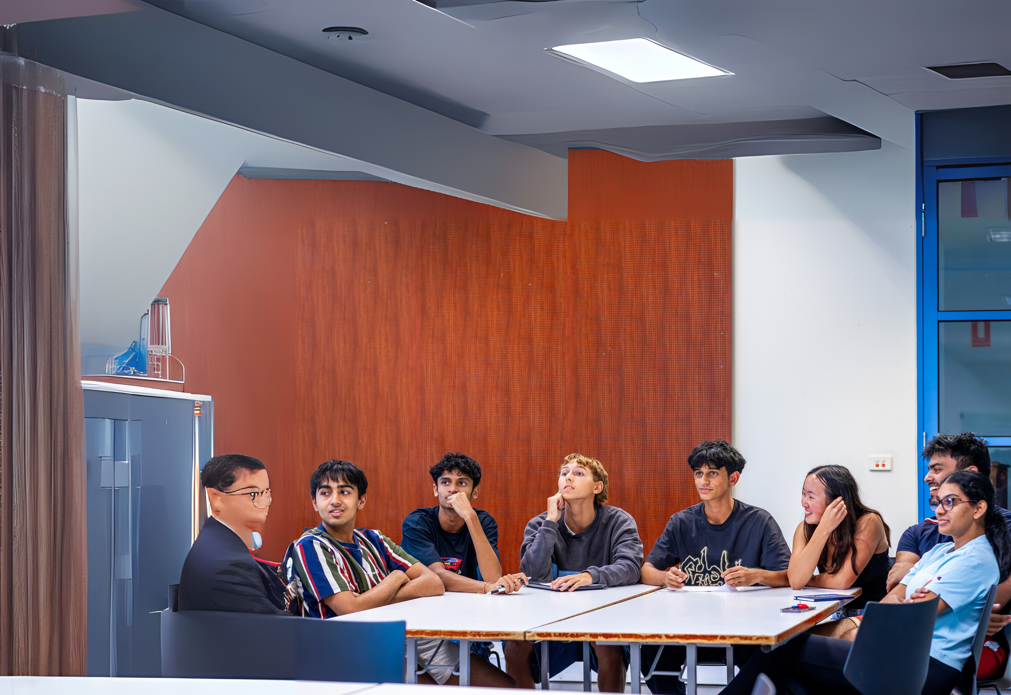




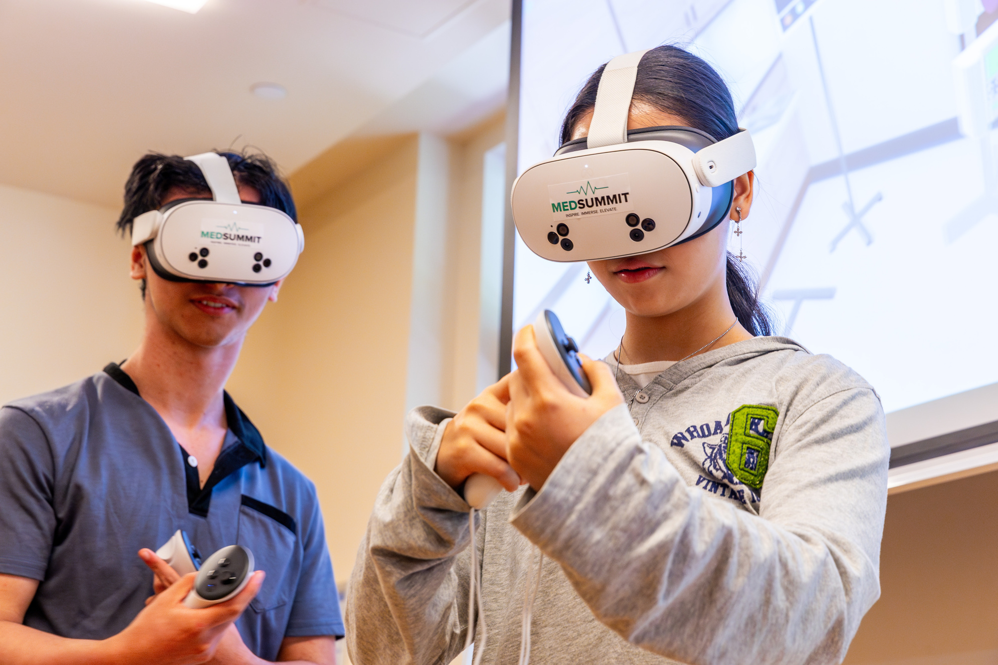








COMPLETE
MEDICAL ENTRY
PREPARATION CAMP
UCAT mentoring & ATAR Hacks
Medical Interview Tips & Tricks
Clinical skills Experience
All meals & Premium en-suite
accommodation
Networking with medical students
& specialist doctors
Fun social activities
January 2026
Yr 10-12 students

Slide 49
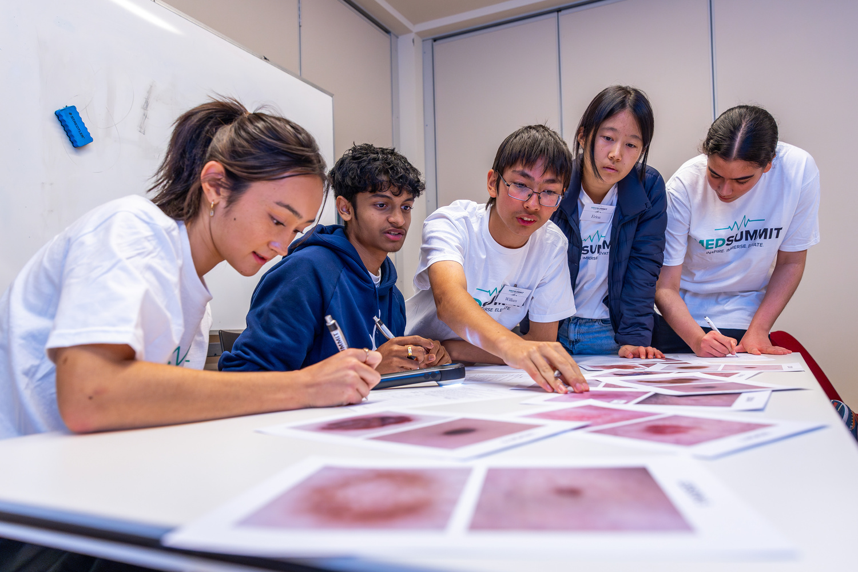
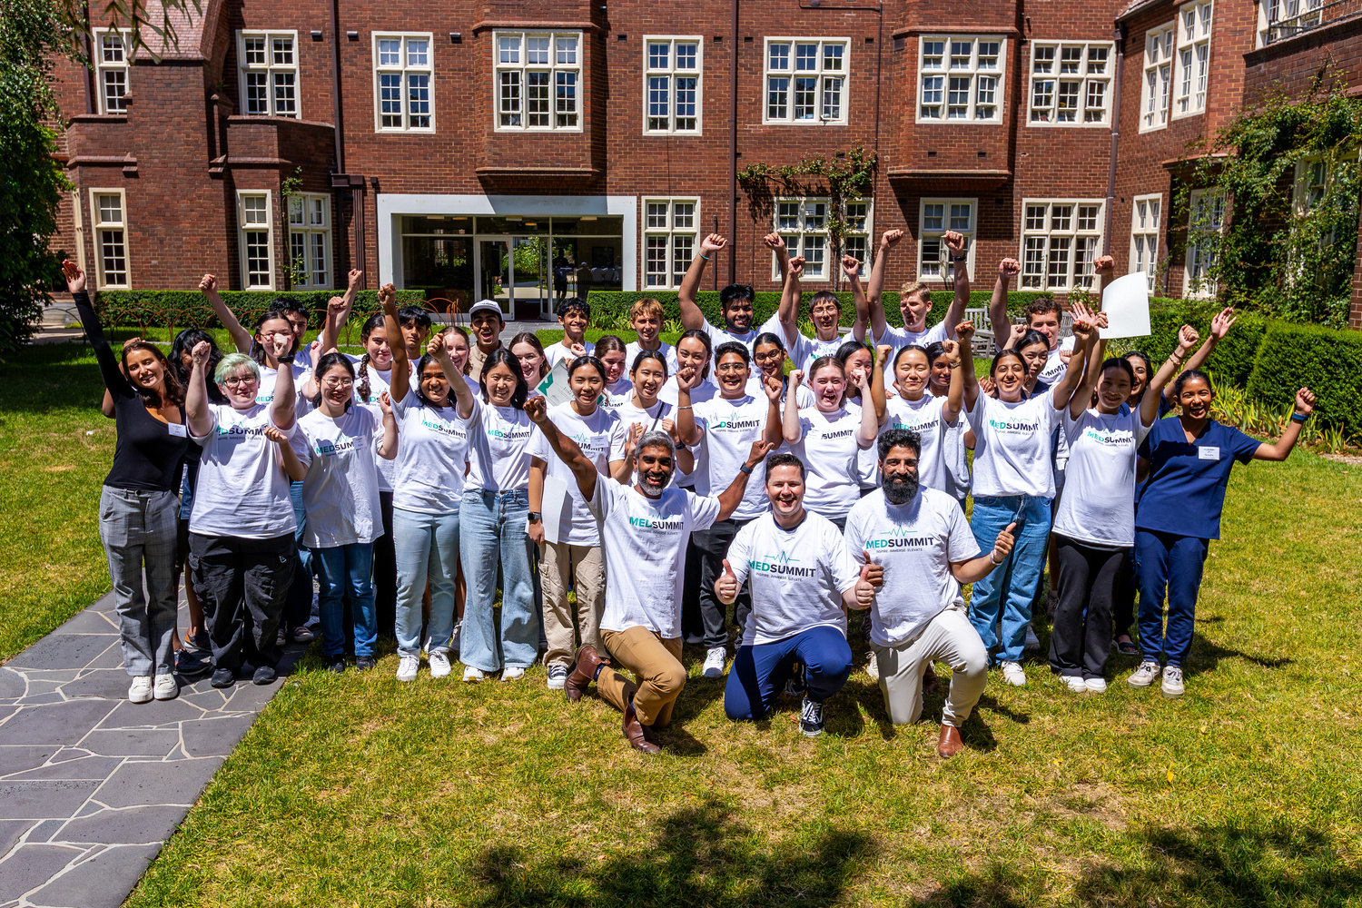

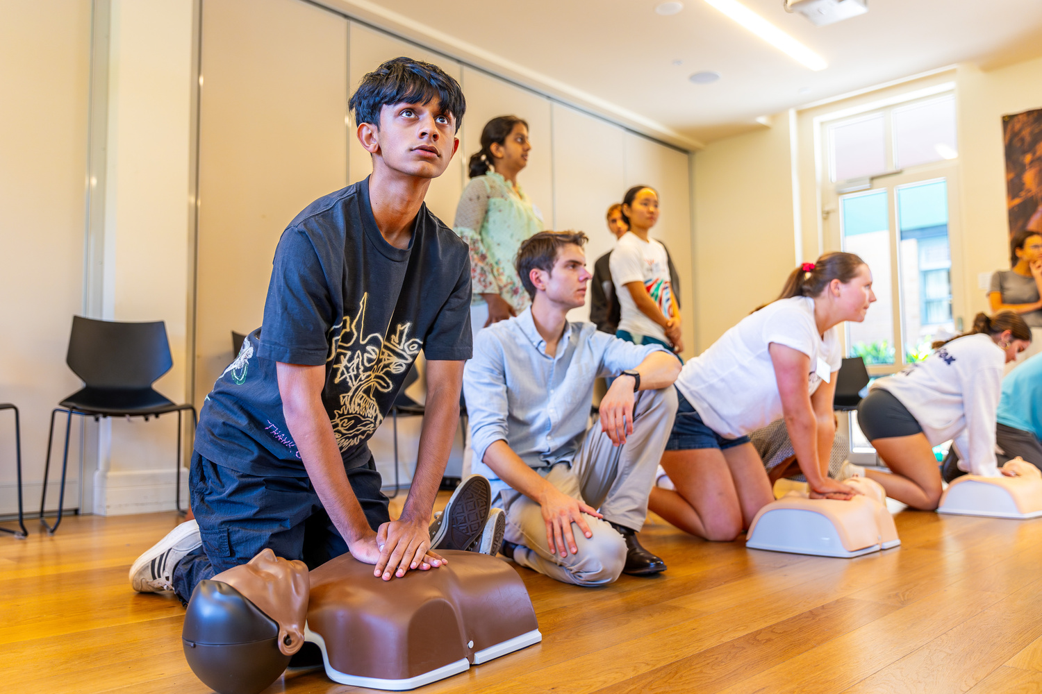




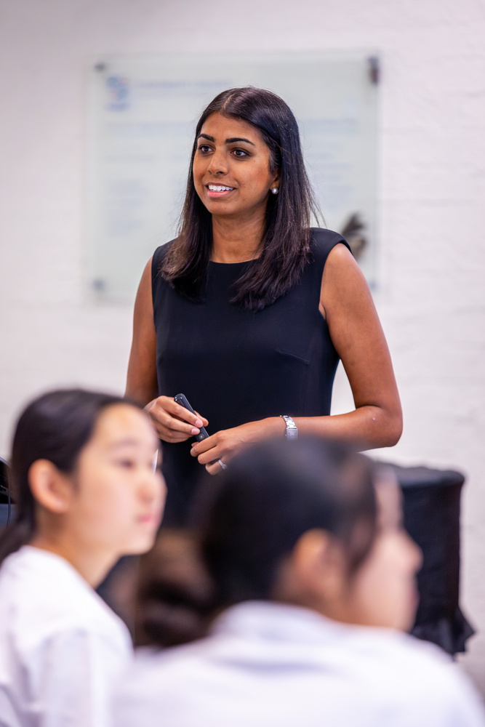
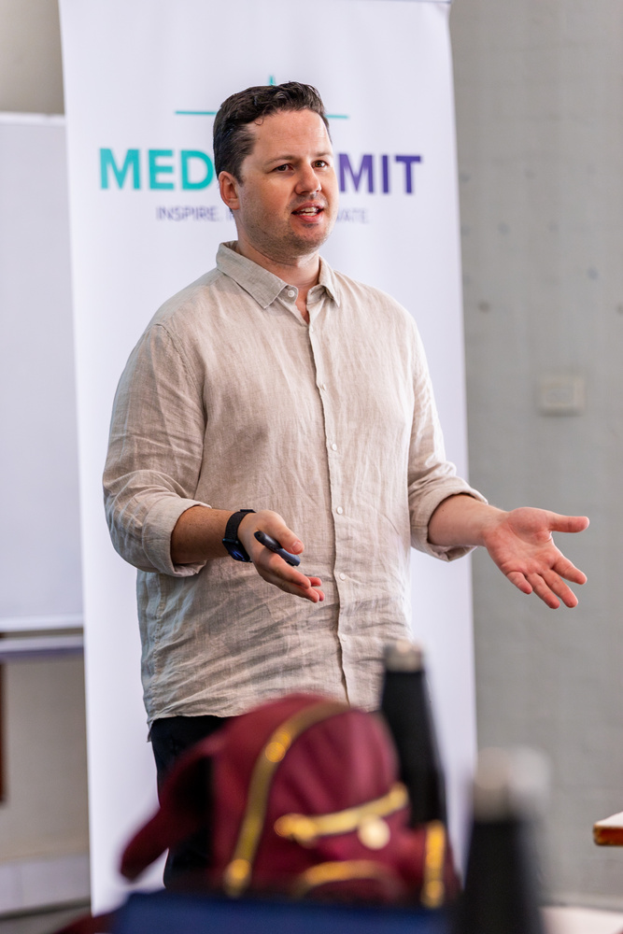
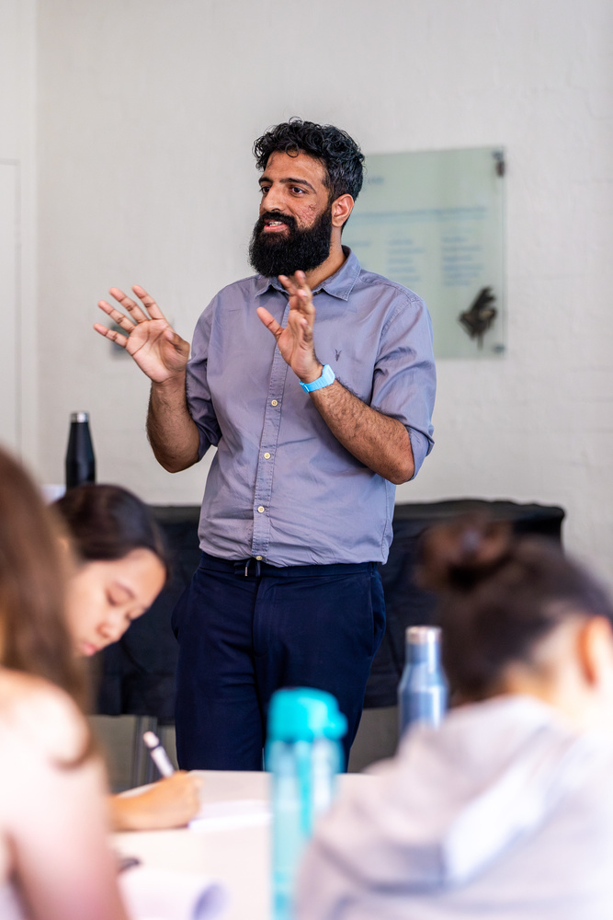

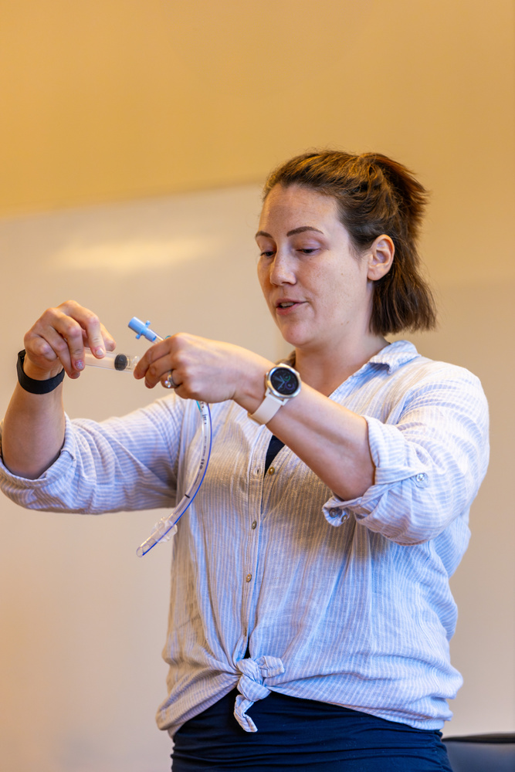
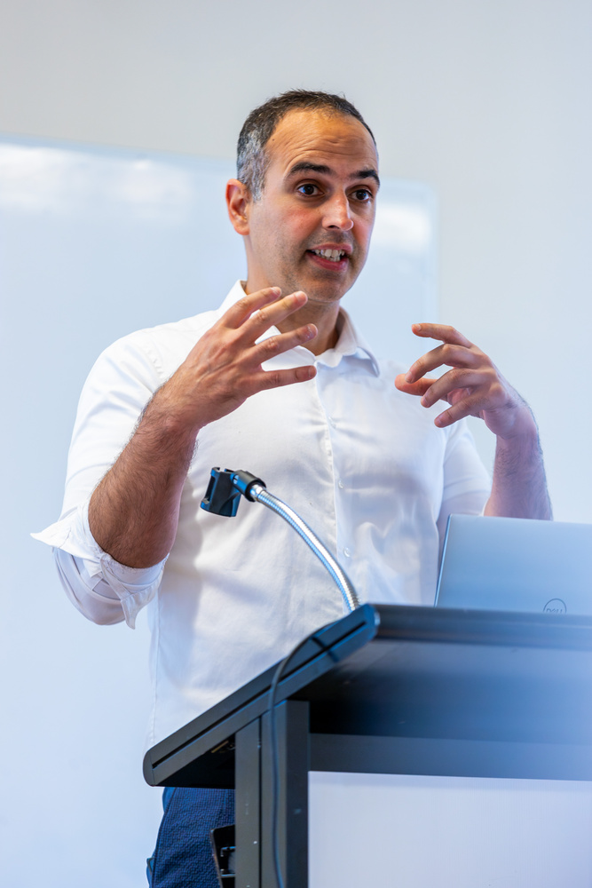
Melbourne & Sydney
January 2026
SCAN TO LEARN MORE
Powered by
www.medsummit.com.au

Slide 50



https://www.linkedin.com/in/dr-ray-boyapati/
@dr.rayb
Questions?

