Slide 1

Becoming a Doctor
29 October 2025

Slide 2
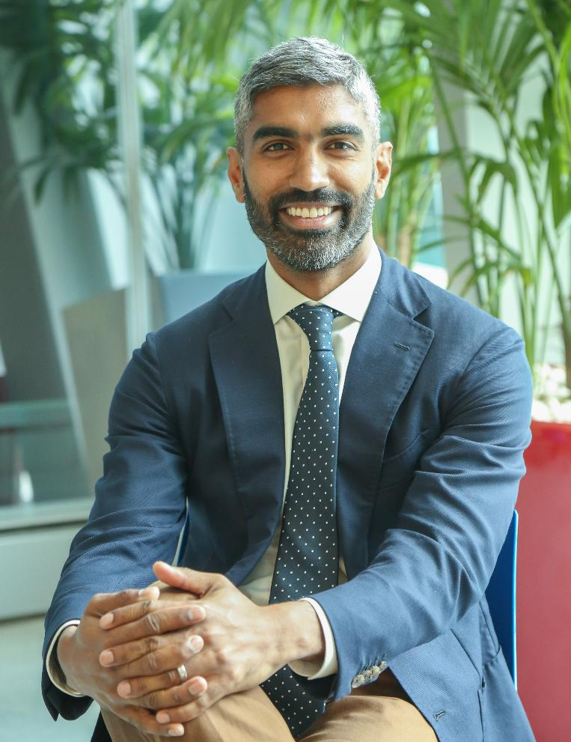
Dr Ray Boyapati
MBBS (Hons I), MD, FRACP, FGESA

Slide 3











MBBS (Hons I)
100th Percentile
Doctorate
ATAR
99.9
FRACP Medal
MHS School Captain
Gastro-enterologist
Accepted into
All Medical Schools
Dr Ray Boyapati
MBBS (Hons I), MD,
FRACP, FGESA
Monash University
Scholarship to Study Medicine
Taught Tens of Thousands of Students

Slide 4
What one word best describes the medical admission process to you?

Slide 5
Plan for this webinar
01
Medical entrance – Practical Advice
For Careers Teachers
02
Free Resources & How we can help
03
Q & A
Let’s find out who is on the webinar today

Slide 6


Medical Entrance
Practical Advice

Slide 7
How confident do you feel advising students about medical school entry pathways?

Slide 8


The Steps to Get Into Medicine
medentry.edu.au/teachers

Slide 9



Pathways into Medicine
Direct
1
Undergrad
Medicine
UCAT
ATAR
Interview
Monash, UNSW, Newcastle/UNE, WSU/CSU, Adelaide, Curtin, UTas, Bond*, JCU*
*No UCAT
School Leaver
Entry
Guaranteed/
Provisional
2
Undergraduate Degree
Postgrad
Medicine
Gap Year
ATAR +/-
UCAT +/-Interview
UQ, UWA, Flinders, Notre Dame , UMelb*, USyd*, Griffith*
Year 12
Non School Leaver Entry
Non-Standard
Entry
Undergrad
Medicine
* No UCAT
** From own uni
*** From own uni or grads from anywhere
3
ATAR/GPA
UCAT
Interview
UNSW, WSU/CSU, Newcastle/UNE, JCU*
Adelaide**, Utas**, Curtin***
Undergraduate
Degree
4
Graduate Entry
Postgrad
Medicine
* Monash grad med no GAMSAT but undergrad has to be one of a few specified Monash courses
GAMSAT*
GPA
Interview
UQ, Griffith, Umelb, Deakin, Notre Dame (Syd, Freo), UWA, ANU, Wollongong, Macquarie

Slide 10
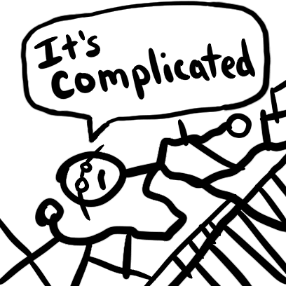

Slide 11
Practical Advice
Students should consider applying everywhere including interstate
If students don’t “get in” from high school, there are many other pathways
This is a continuously changing and complex area

Slide 12




Requirements for Medicine – Undergraduate Entry
+
+
→
1/3 ATAR
1/3 interview
Academic Grades
UCAT
Interview
Medicine
1/3
UCAT
Prerequisite Subjects

Slide 13
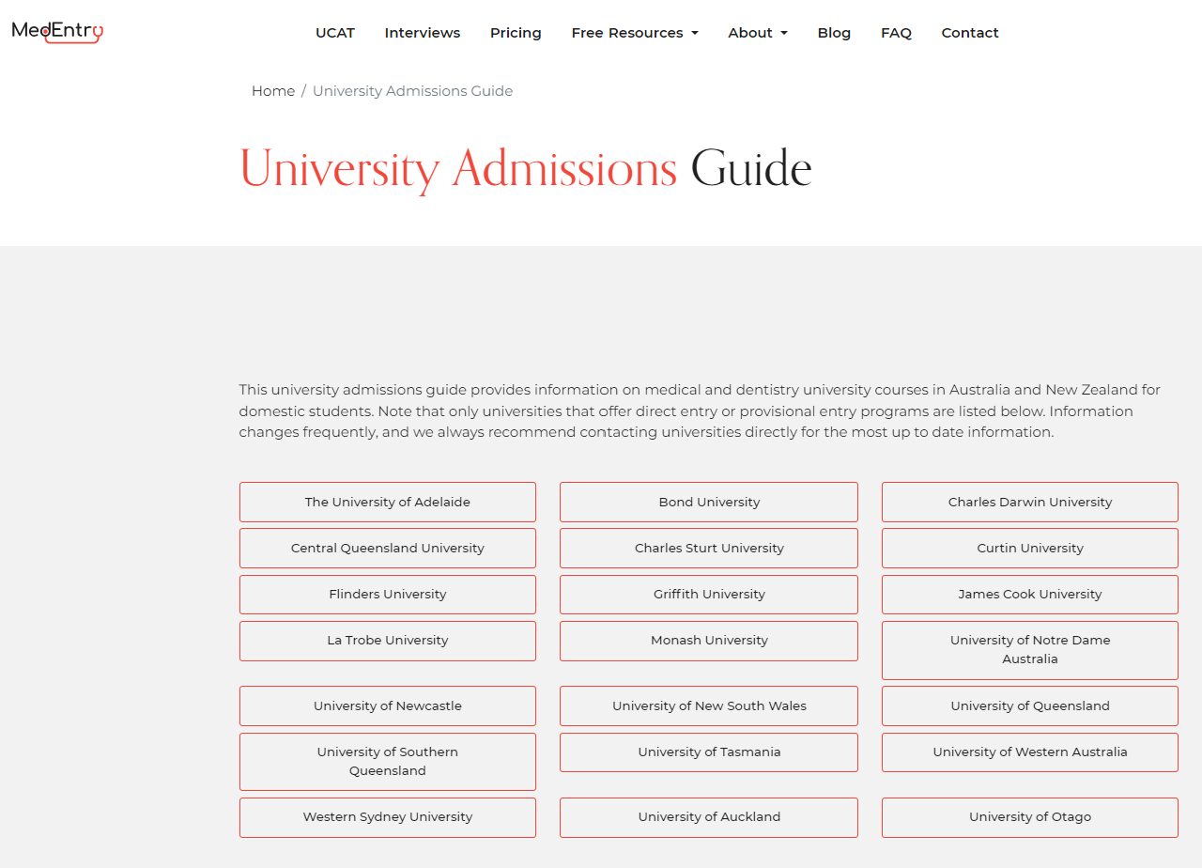
Academic Component
www.medentry.edu.au

Slide 14

Academic Component
BUSTED
Year 12
Common Myth
Have to do science subjects to enter medicine
Common Myth
Have to get extremely high ATAR scores to enter medicine

Slide 15

ATAR
The Process

Slide 16

The Process
Swim
Run
Cycle
ATAR
UCAT
Interviews

Slide 17
+
+
→
1/3 ATAR
1/3 Interview
Academic Grades
UCAT
Interview
Medicine
1/3
UCAT
Prerequisite Subjects

Slide 18

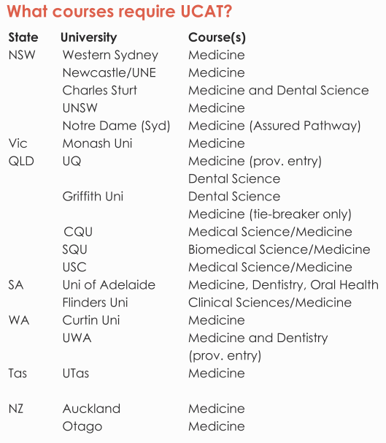
Who needs to sit the UCAT?

Slide 19
Scoring
What is a ‘good’ / high score?

Slide 20







What are the changes to UCAT?
UCAT
Verbal Reasoning
Decision Making
Quantitative Reasoning
Abstract Reasoning
Situational Judgement
1 minute
6 minutes
6 questions
1 minute

Slide 21
Requirements for Medicine – Undergraduate Entry
+
+
→
1/3 ATAR
1/3 interview
Academic Grades
UCAT
Interview
Medicine
1/3
UCAT
Prerequisite Subjects

Slide 22
Importance of Interviews
At many universities, once you get to the interview stage, it becomes the most important factor for medical entry

Slide 23
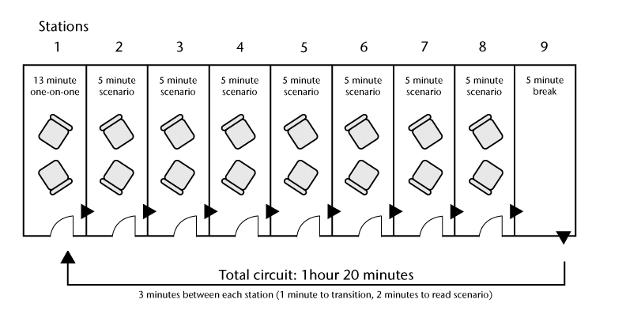
MMIs

Slide 24
Common Themes Assessed
Motivation to study medicine
Current issues in health
Ethics
Empathy
Critical thinking
Teamwork and leadership skills
Self-awareness
Understanding of the university and medical program
Rural and Indigenous health (Maori health at Auckland)

Slide 25
Criteria Used
Communication skills
Critical thinking
Decision making
Social responsibility
Empathy
Moral and ethical reasoning
Self-awareness
Maturity
Awareness of health issues
Teamwork and leadership
Quality of motivation to study medicine

Slide 26
Timeline
UCAT Bookings Open
UCAT Results to Unis
Y 12 Results
1st Round Uni Offers
Feb-May
July
Early September
Oct-Dec
Mid Dec
Nov/Dec/Jan
Mid Jan
Late Jan/Feb
Sit UCAT
UCAT Results
Interview offers
Interviews
2nd/3rd Round Offers

Slide 27
How MedEntry Can Help

Slide 28


Free Getting into Medicine Help For Your Students
medentry.edu.au/resources/free

Slide 29


Free Aspring & Applying Webinars
medentry.edu.au/resources/medical-entry-webinars
Next one: 18th November 7:30pm

Slide 30

Which UCAT & Interview Prep Provider?
Who runs the organisation?
What is their teaching record?
Have they got a track record of success?
How are their public reviews?
*Late bookings 31 May ($85 extra)
*Final late bookings 5 June ($185 extra)

Slide 31


Slide 32
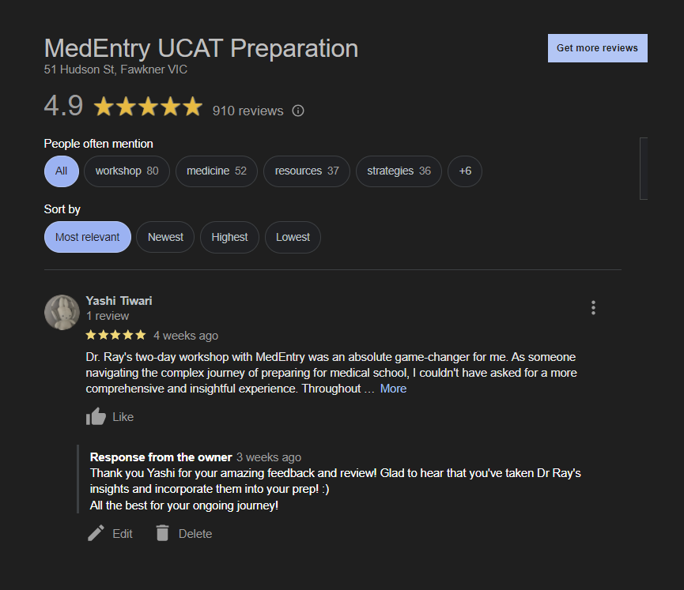



Slide 33
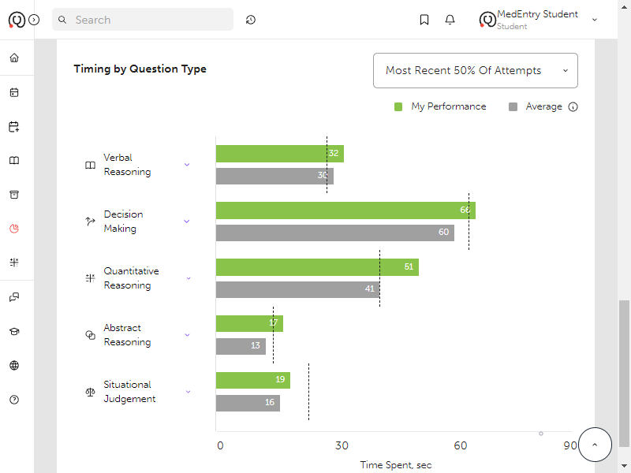
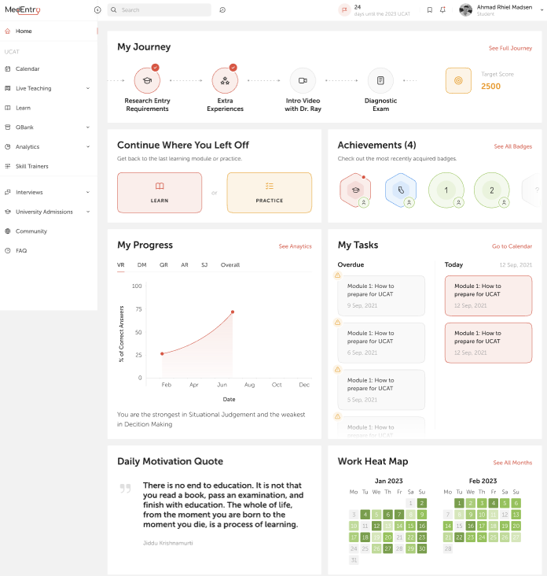
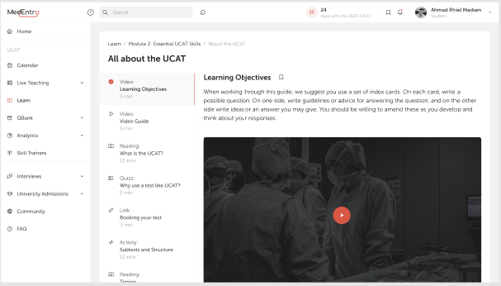

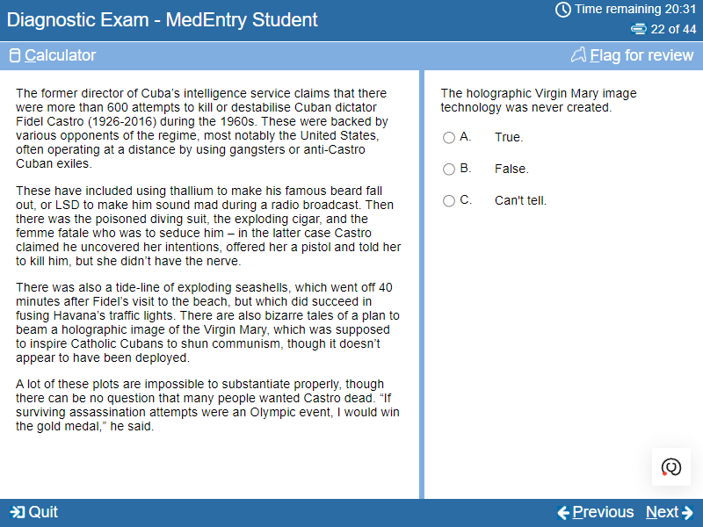
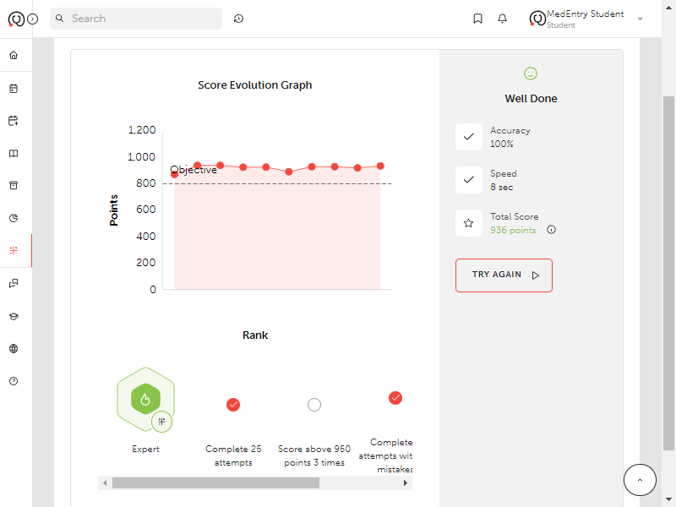
Online Learning Platform

Slide 34


More than just a “Question Bank”
MedEntry AI
Error logging
Skills Trainers
Complete video curriculum
Detailed feedback

Slide 35
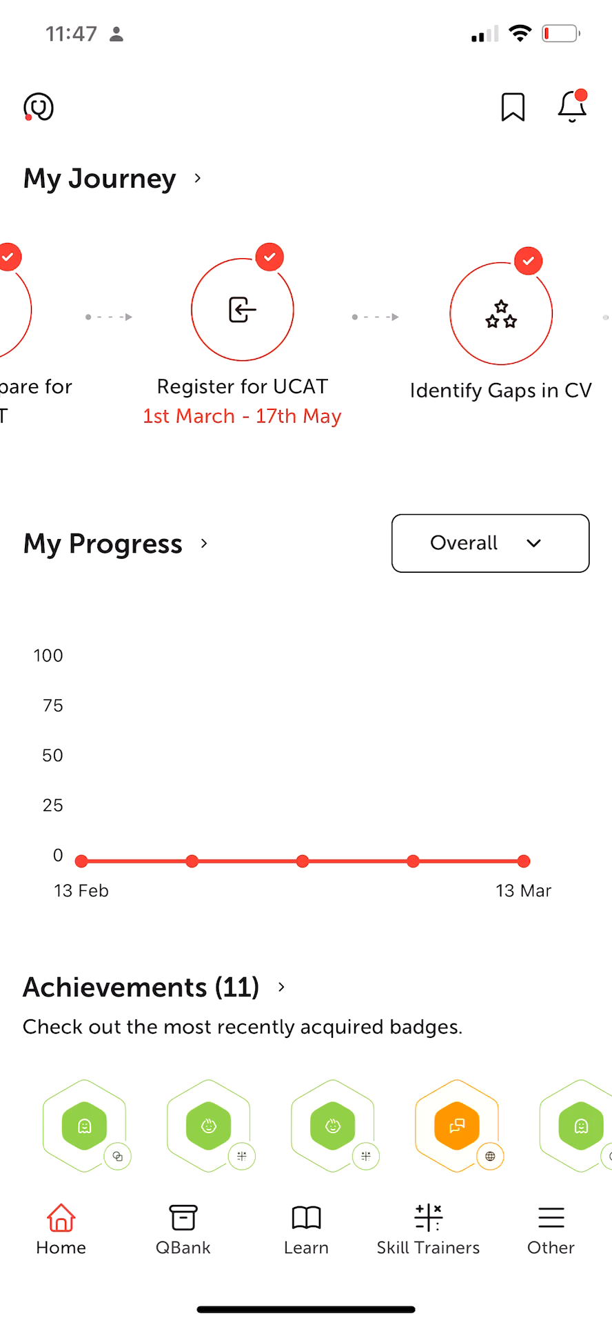
State of the art mobile App

Slide 36
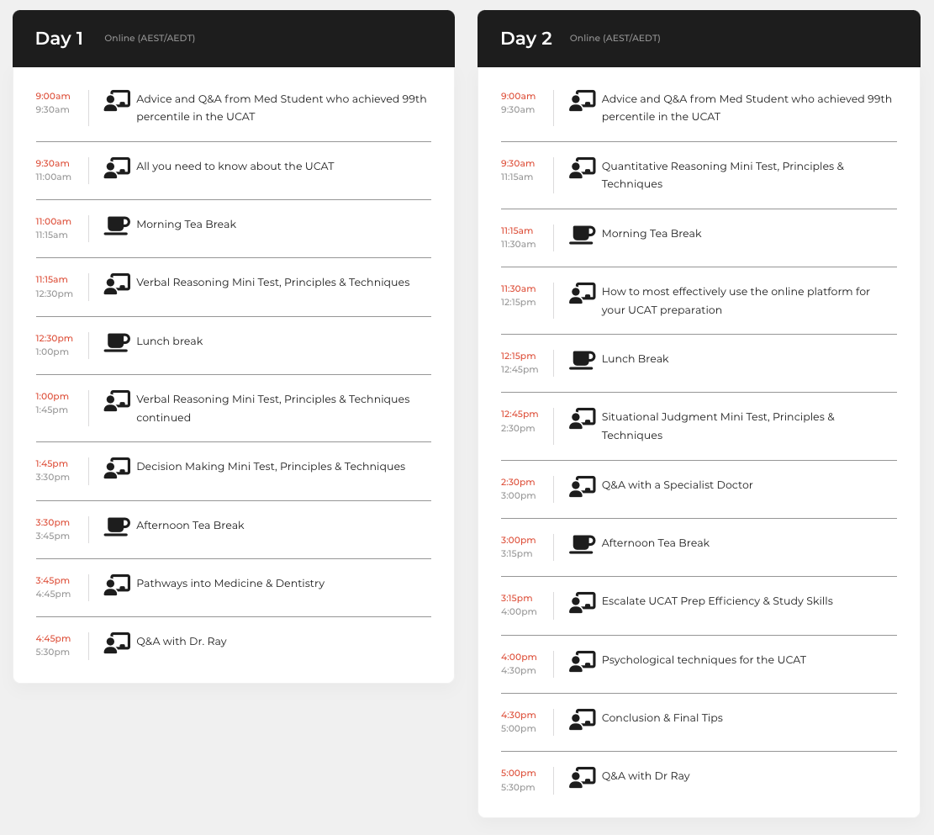
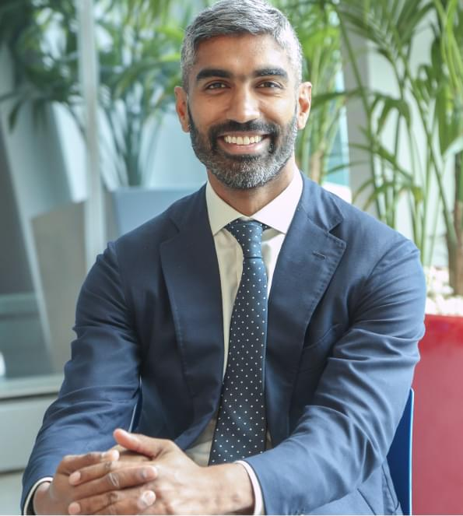
2 Day Workshops
with Dr Ray

Slide 37
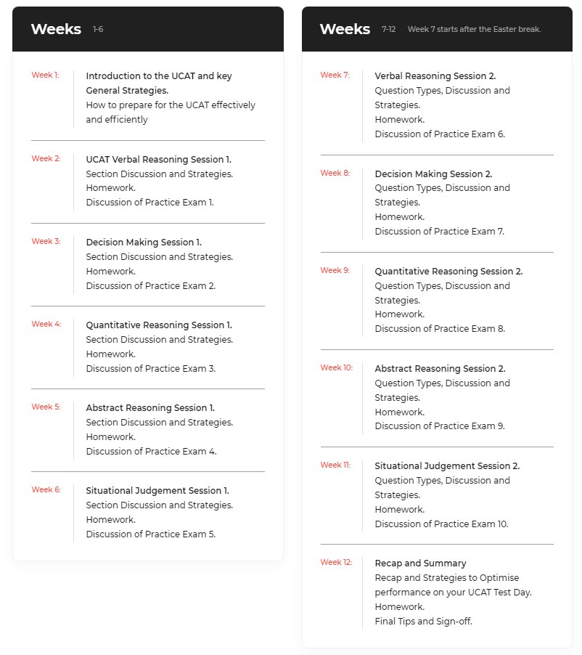
Weekly UCAT Training
or 1-on-1 training

Slide 38

Medical Interview Training

Slide 39
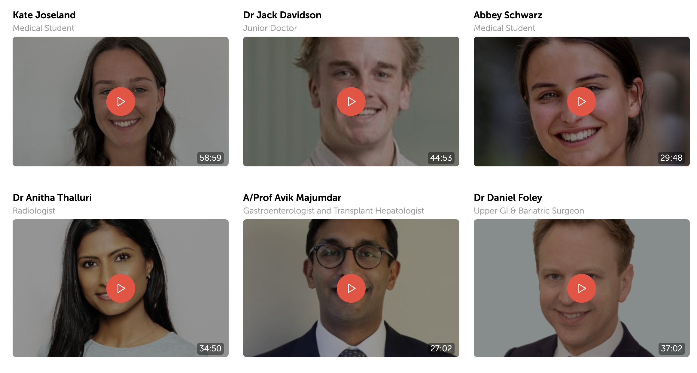

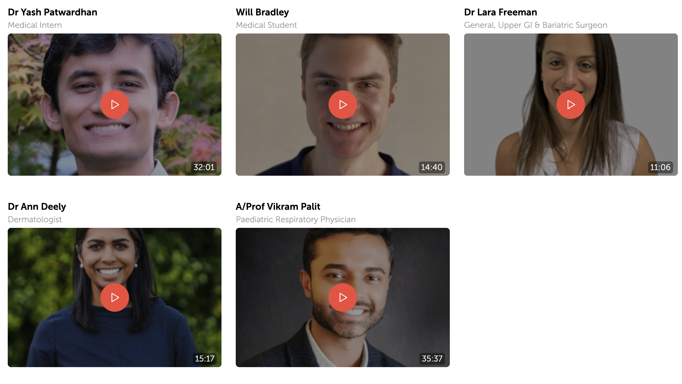
Virtual Work Experience
Included in all MedEntry Premium & Comprehensive packages
Fantastic for student learning, motivation and interviews!

Slide 40
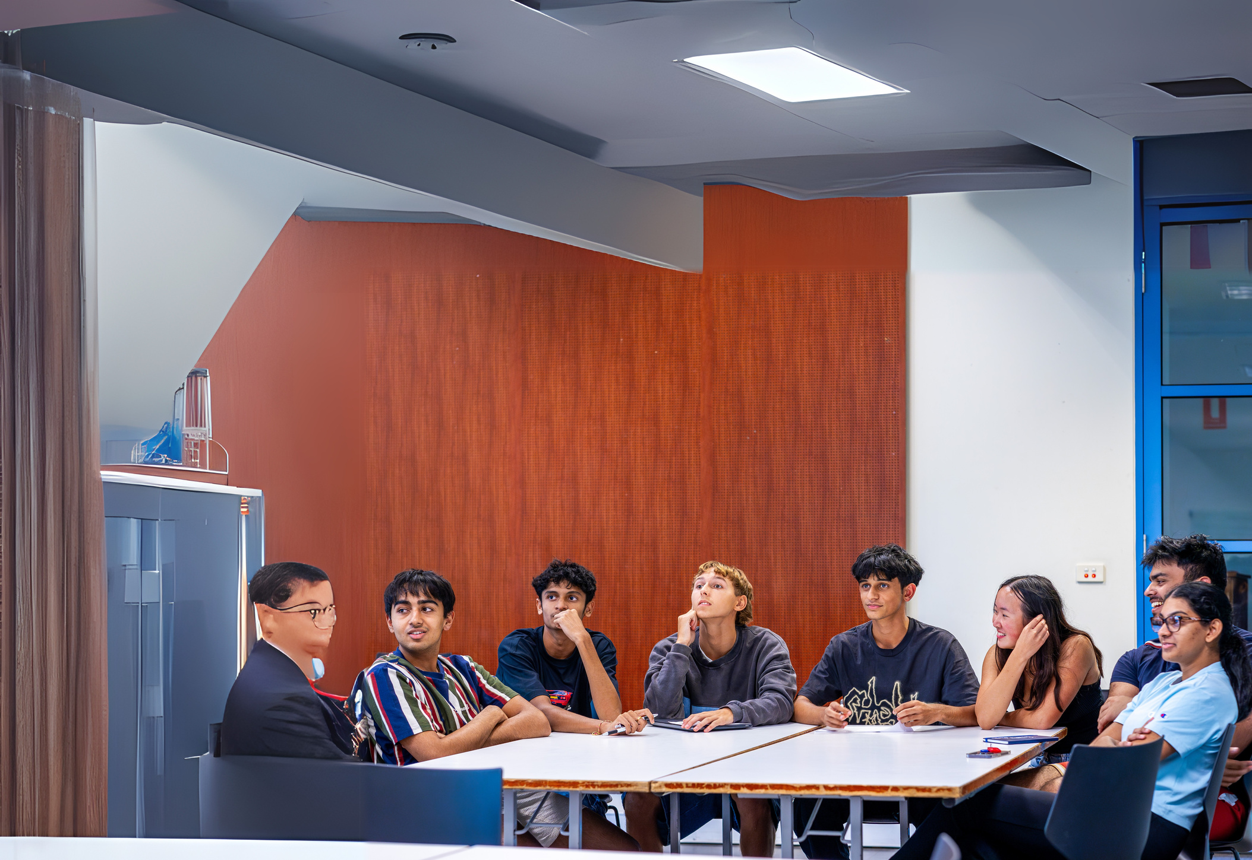




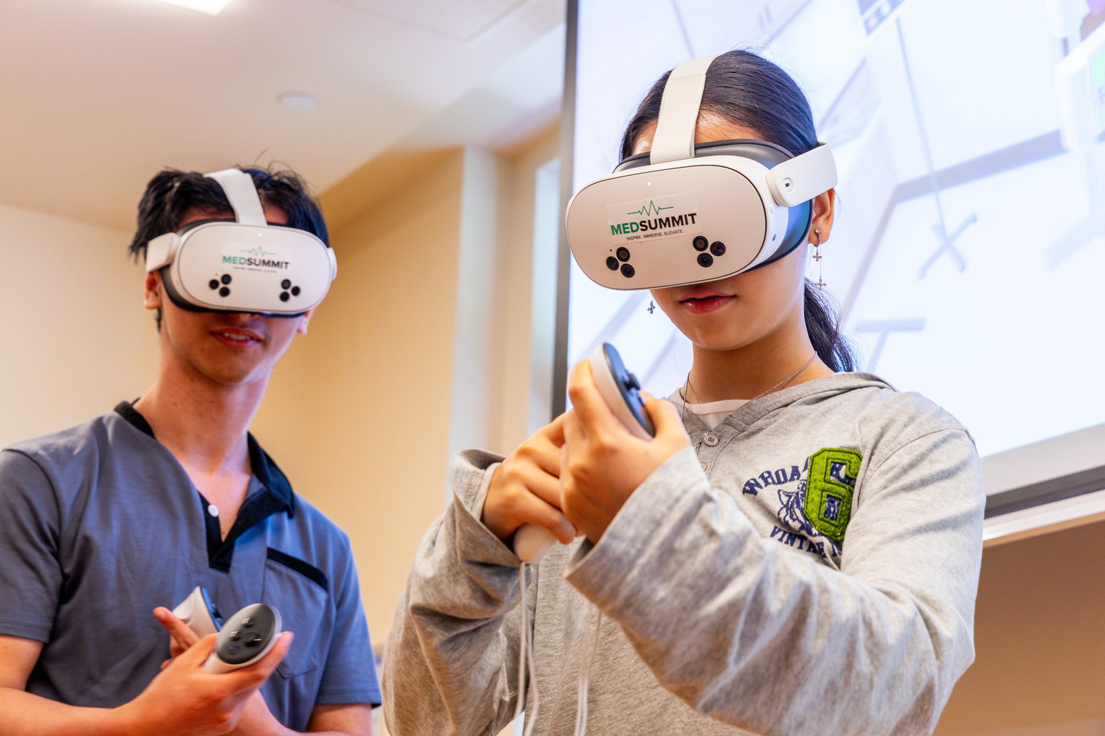








COMPLETE
MEDICAL ENTRY
PREPARATION CAMP
UCAT mentoring & ATAR Hacks
Medical Interview Tips & Tricks
Clinical skills Experience
All meals & Premium en-suite
accommodation
Networking with medical students
& specialist doctors
Fun social activities
Melbourne 13-16 January
Sydney 20-23 January
Yr 10-12 students

Slide 41
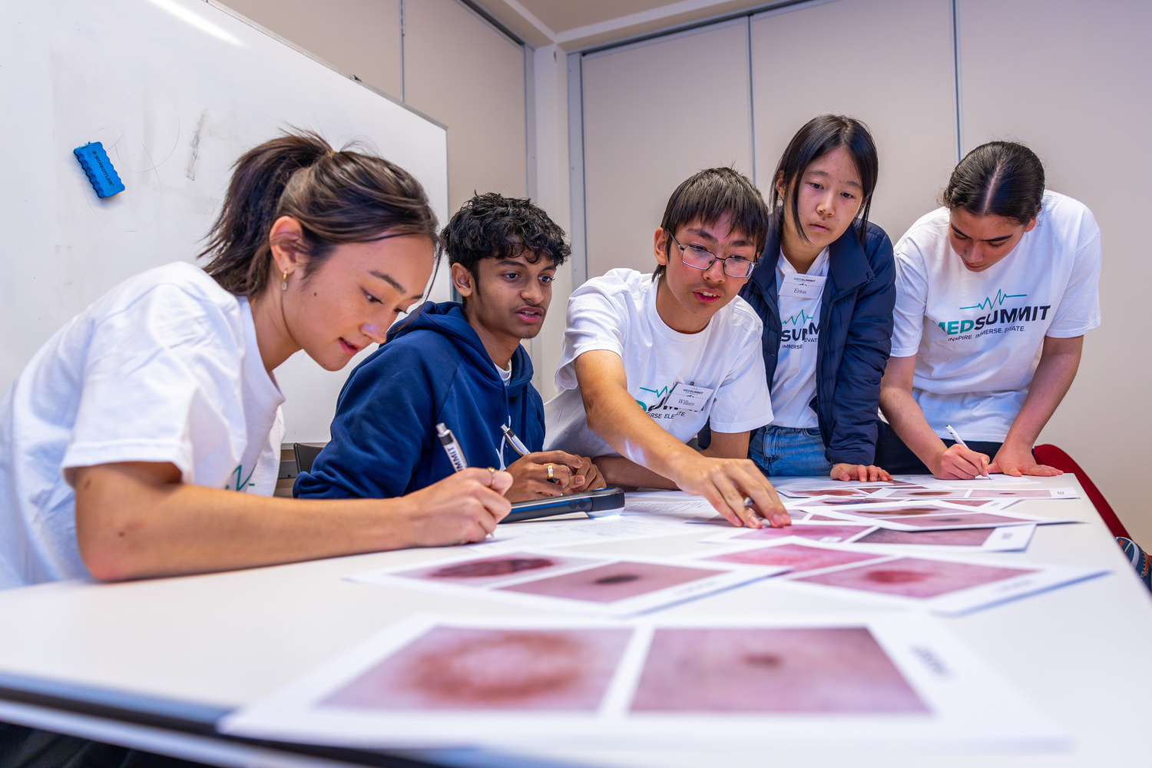
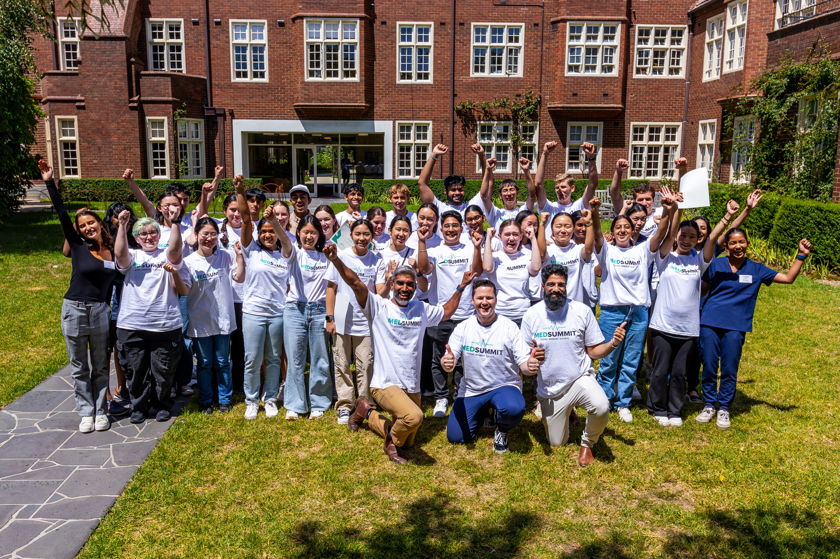

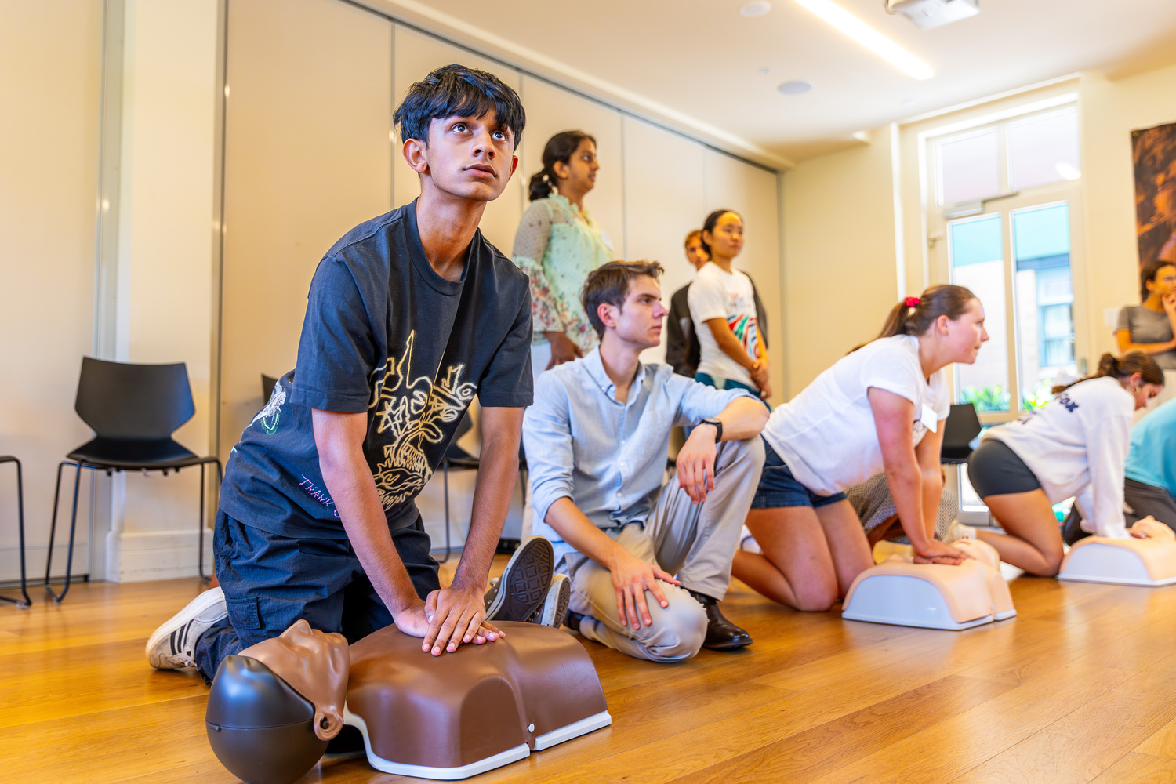
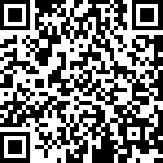




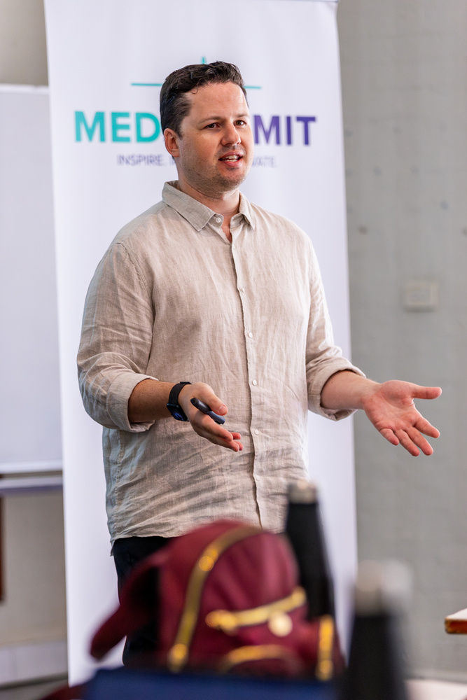
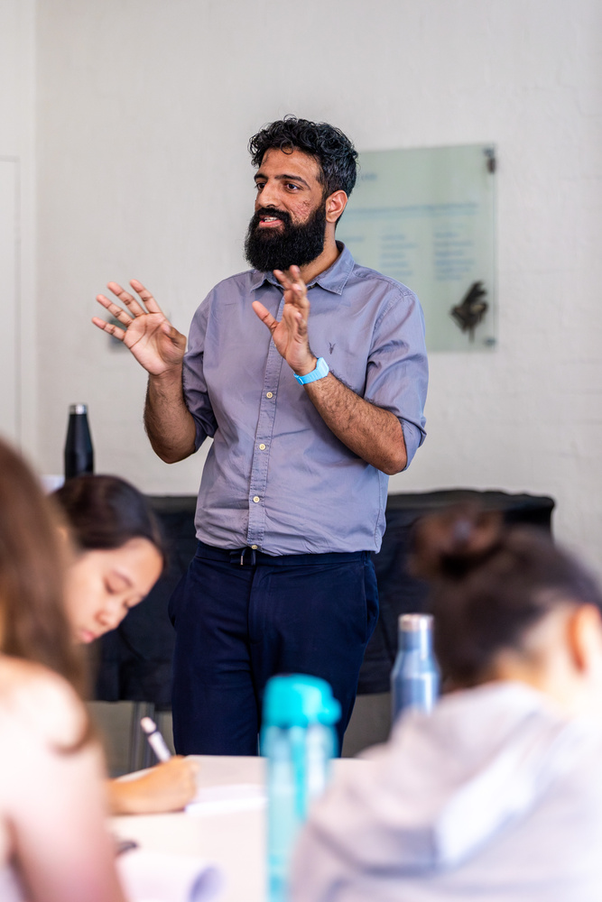

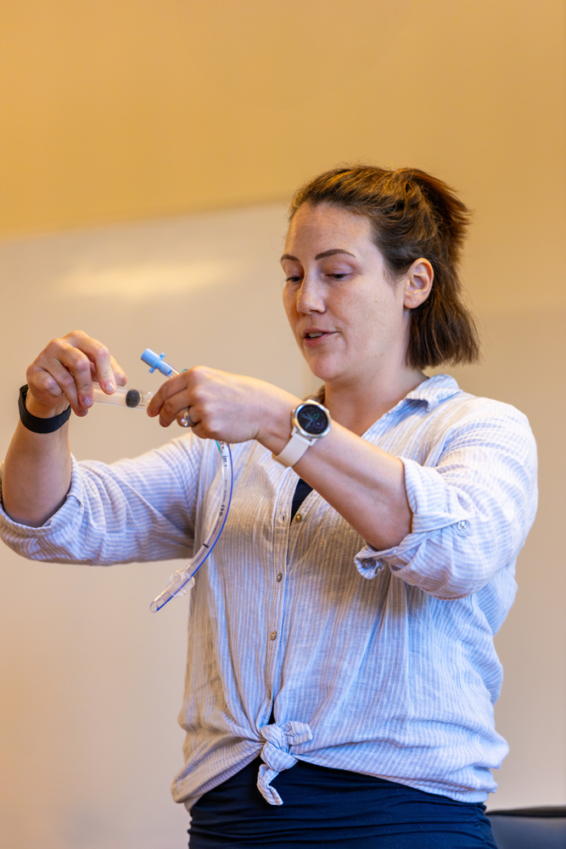
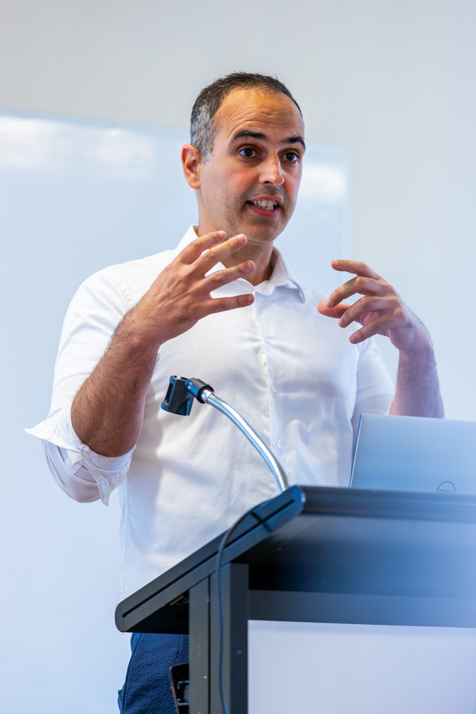
Melbourne & Sydney
January 2026
SCAN TO EXPRESS INTEREST
Powered by
www.medsummit.com.au

Slide 42
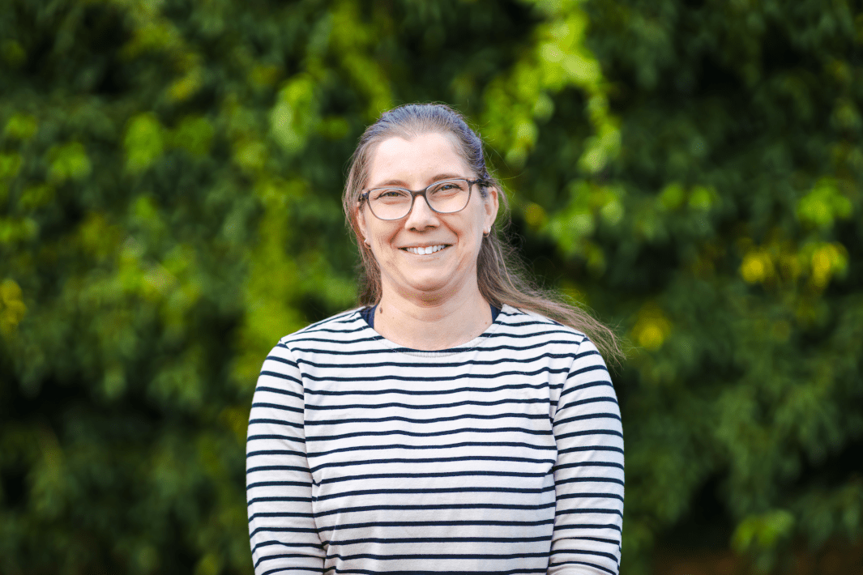

Questions About Preparation?
Feel free to contact Alicia or Sylvie in the office
(03) 9359 9960 or
1300 MEDENTRY
More information & enrol via
www.medentry.edu.au

Slide 43

Melbourne
22 November
Sydney
29 November
Brisbane
30 November
Register on Eventbrite
$5 entry – all to charity

Slide 44



Slide 45



https://www.linkedin.com/in/dr-ray-boyapati/
@dr.rayb
Questions?

