Slide 1
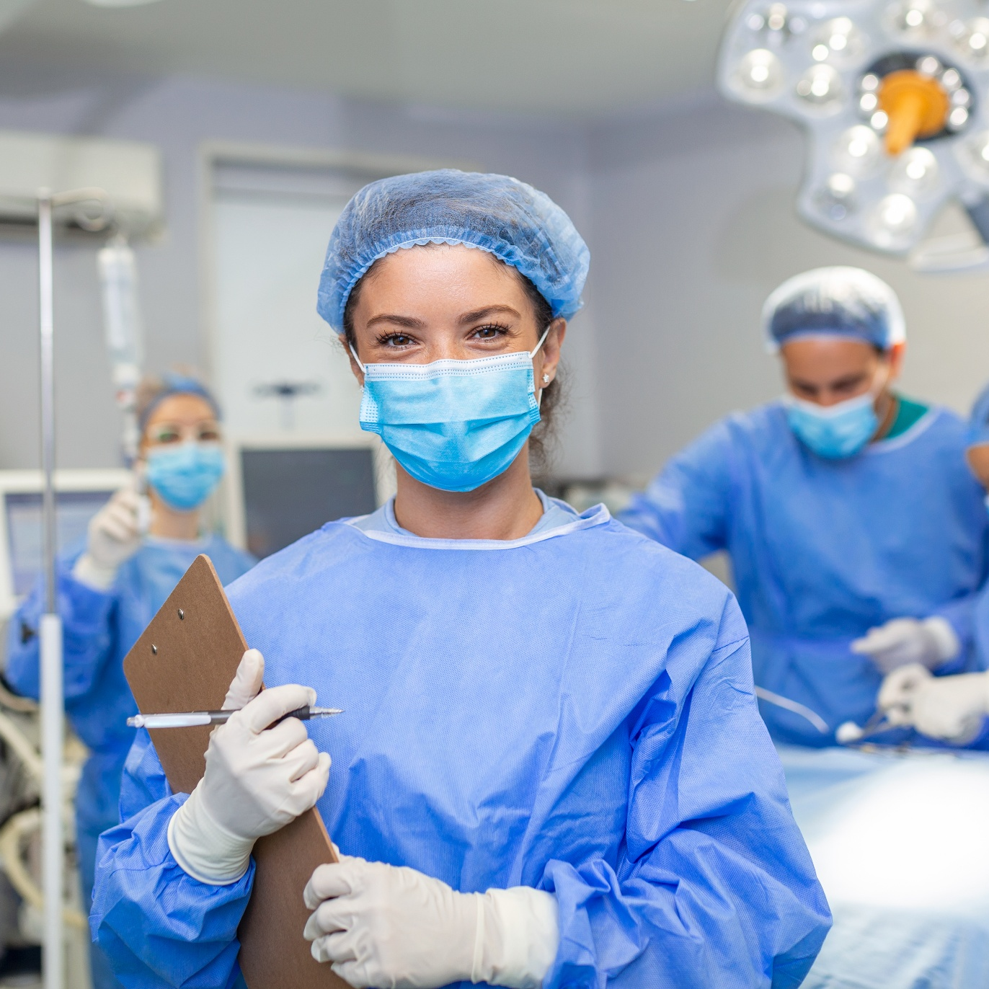
Medical Entry & HPAT
Dr Ann Deely

Slide 2
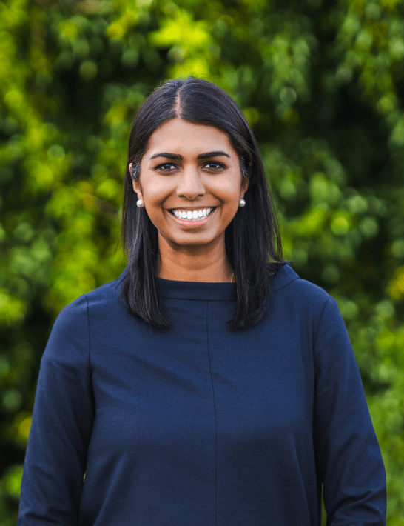
Dr Ann Deely
MBBS Hons1 (Monash) | RCPI (Ireland) | FACD (Dermatology)

Slide 3
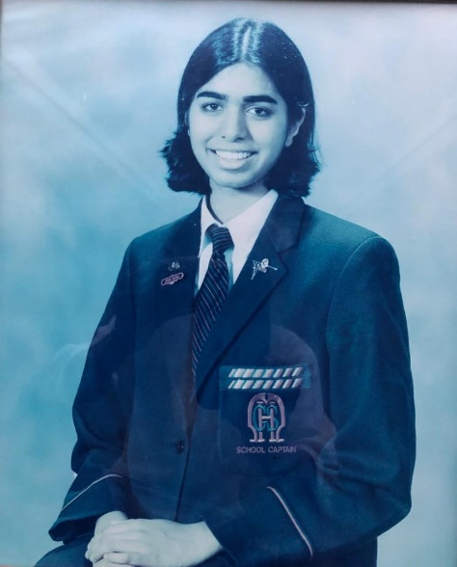








MBBS First Class Honours
100th Percentile
ATAR 99.9 (625 LC)
FACD Medals
in all 3 sections
School Captain
Dermatologist
Dr Ann Deely
MBBS Hons1 (Monash) |
RCPI (Ireland) | FACD (Dermatology)
Accepted into
All Medical Schools
>20,000 students over >25 years
Scholarship to Study Medicine
HPAT expert

Slide 4
Plan for this webinar
01
Advising students about medicine as a career
02
Medical entrance in Ireland, including changes
03
The HPAT
04
Free Resources, How we can help, Q & A

Slide 5


Medicine as a Career

Slide 6

Advantages of Medicine
Work with people
Interesting
Challenging
Satisfying, rewarding
Diversity of careers
Contribute to advances in knowledge
Flexibility in working hours
Job security, self-employment
Trusted/valued profession

Slide 7
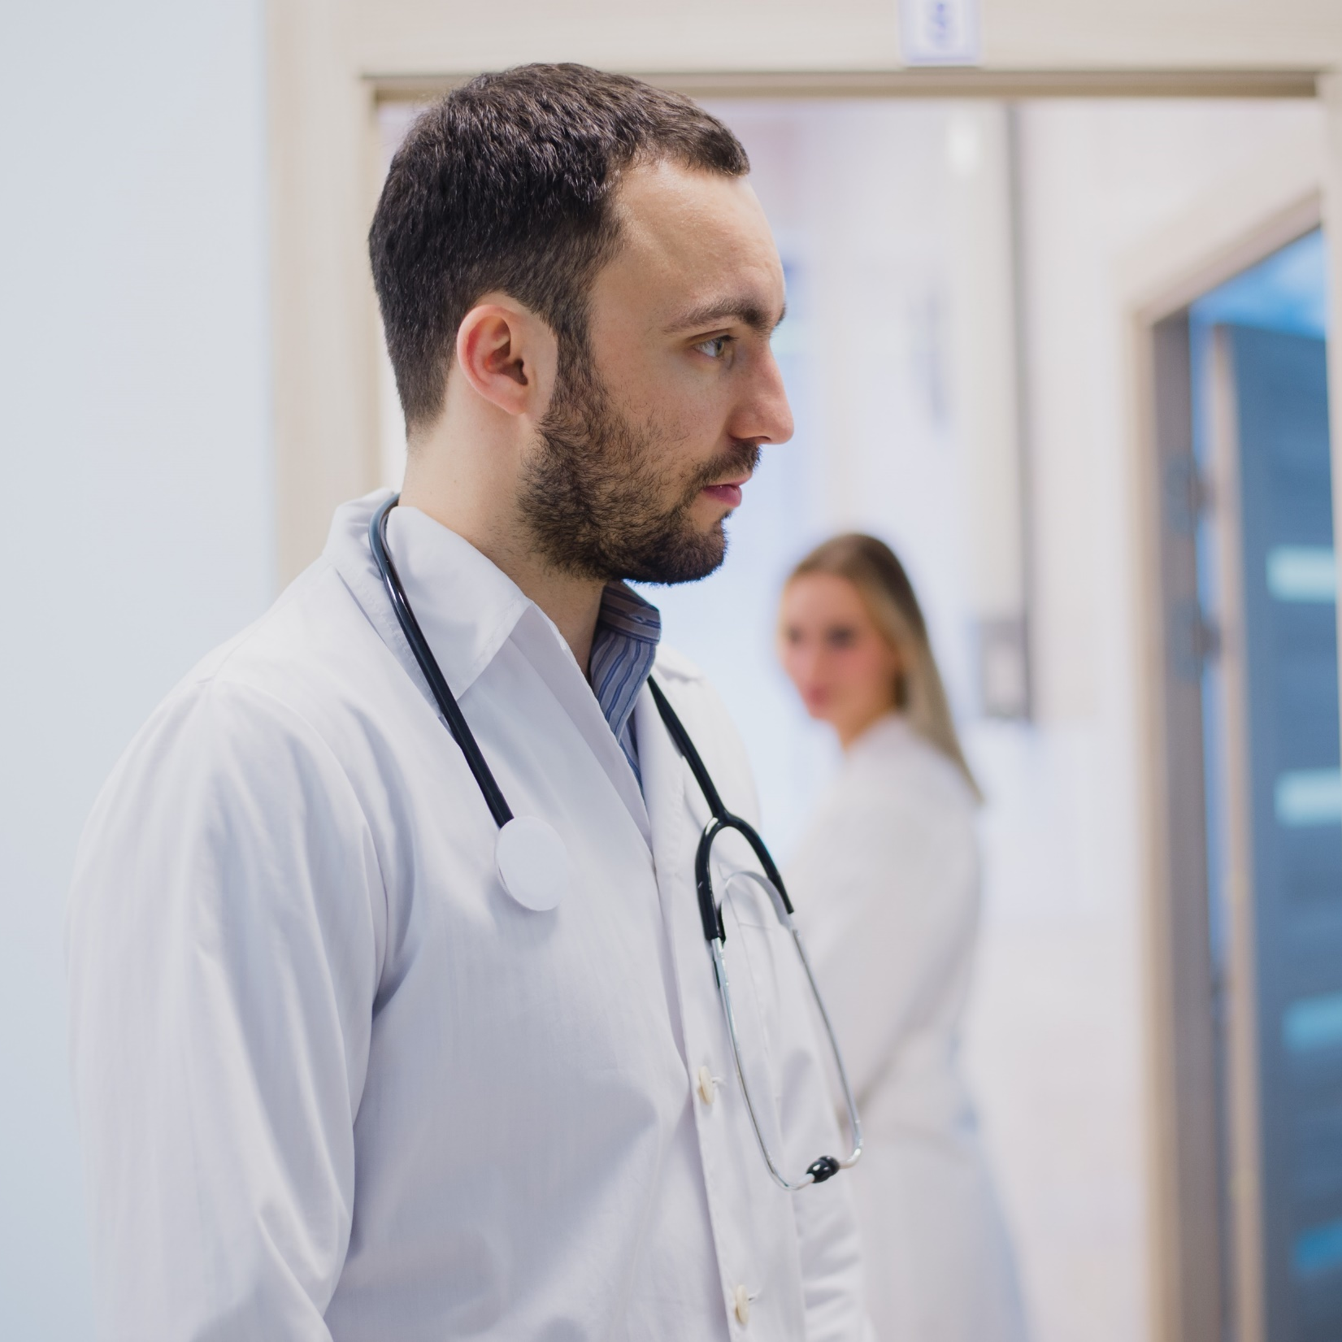
Disadvantages of Medicine
Length and cost of study
Shift work
Workload
Stress
Caring for sick people
Legal liability
Bureaucratic regulations
Lack of resources
Balance of work / personal life

Slide 8
Specialties
Physician | Surgeon | Other
General Physician Gastroenterologist Cardiologist Respiratory Physician Renal Physician Endocrinologist Oncologist Neurologist Rheumatologist Immunologist Haematologist Infectious Diseases Geriatrician Dermatologist | General Surgeon Maxillo-Facial Surgeon Cardiothoracics Orthopaedics Plastics and Reconstructive Surgery Neurosurgeon ENT Surgeon Otolaryngologist Paediatric Surgeon Vascular Surgeon Urologist Transplant Surgeon Trauma Surgeon Colorectal Surgeon | General Practitioner Emergency Specialist Intensive Care Anaesthetist Obstetrician Gynaecologist Neonatal Physician Psychiatrist Ophthalmologist Pathologist Geneticist Radiologist Allergy Specialist Medical Administrator Rehabilitation

Slide 9
The ‘Medical Aspirant’
Stereotype
Extremely high LC
Excels in science subjects
Has no time for a social life or extra-curricular activities

Slide 10
From Patient’s Perspective
Highest rated quality¹: Humaneness
Caring, compassionate, and kind
Other important qualities²:
  Empathetic
  Personal
  Respectful
  Thorough
  Competent
Wensing M et al. A systematic review of the literature on patient priorities for general practice care. Soc Sci Med
Bendapudi et al, Mayo Clinic Proceedings

Slide 11
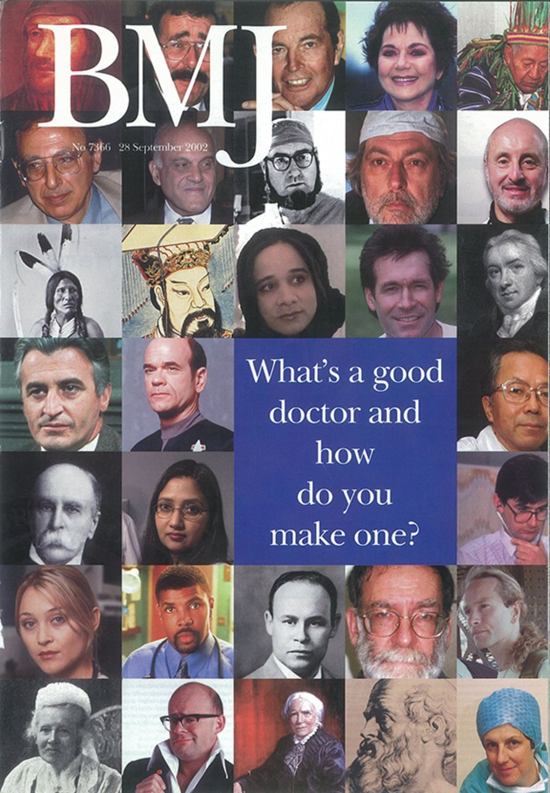
From Doctor’s Perspective
Compassion
Understanding
Empathy
Honesty
Competence
Commitment
Courage
Humanity
Respect
Optimism

Slide 12
Medical Entrance
& 2027 Changes

Slide 13


Medical Entry Requirements
  Leaving Certificate
  +
  HPAT

Slide 14
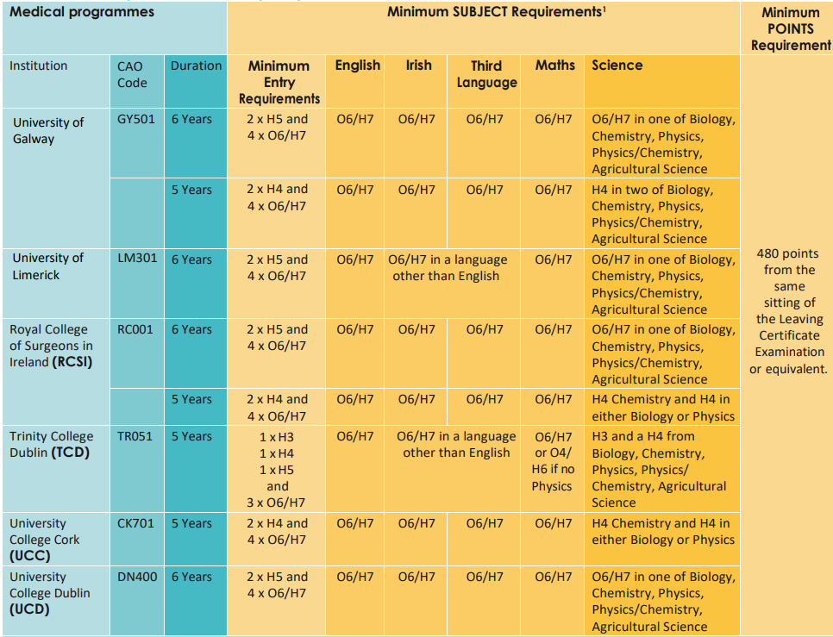
Minimum Subject Requirements
Notes:
https://www2.cao.ie/downloads/documents/2026/UGMedEntry2026.pdf

Slide 15

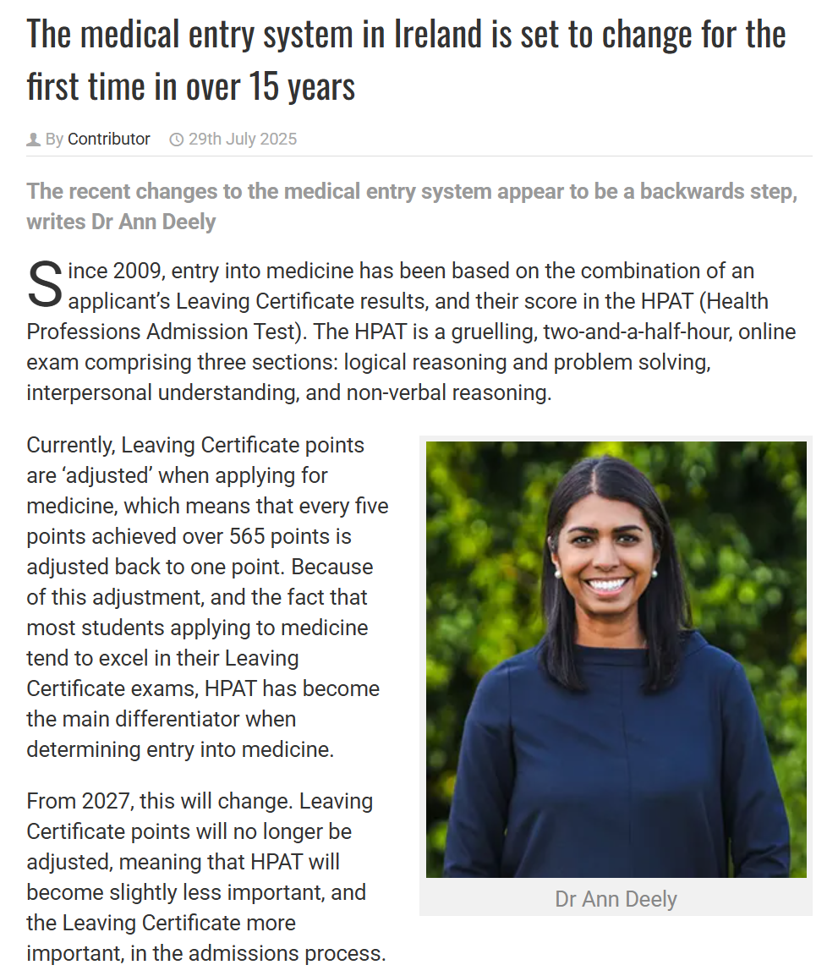
2027 Changes
Leaving Cert Points are no longer adjusted
HPAT scored out of 150 (previously 300)
Total maximum points now (625 + 150 = 775)
Notes:
https://www.imt.ie/opinion/the-medical-entry-system-in-ireland-is-set-to-change-for-the-first-time-in-over-15-years-29-07-2025/

Slide 16
Importance of HPAT
Despite the change to the entry system, HPAT is as important as Leaving Cert for medical entry

Slide 17
Timeline
Register for HPAT
Sit HPAT
CAO offers
Nov-Jan
Nov-Feb
Mid February
Late June
Aug-Sept
Apply to CAO
HPAT results released

Slide 18


Pathways into Medicine
1. HPAT
2. LC
Medicine
School Leaver Entry
5 – 6 years
LC
Graduate Entry
1. GAMSAT
2. Degree grade
Degree
Medicine
8 – 10 years
Other Pathways:
Repeat LC/HPAT
Apply to UK (UCAT)
Apply to EU (Eunicas)

Slide 19
Practical Advice
1. Students should ideally apply everywhere
2. Be careful with CAO change of mind – cut off scores vary from year to year
3. If students miss out on medicine they can try again!

Slide 20

The HPAT

Slide 21
Who needs to sit the HPAT?
Anyone applying for undergraduate medicine!
University College Dublin
Trinity College Dublin
Royal College of Surgeons in Ireland
University College Cork
University of Galway
University of Limerick
  Undergraduate medicine
  MSc Occupational / Speech & Language Therapy

Slide 22
What is the HPAT?
Multiple-choice exam
Since 2021, conducted online via remote proctoring
Tests range of personal skills and aptitudes
Tests ability to think quickly, not ability to recall facts
Designed to test skills that doctors should possess

Slide 23
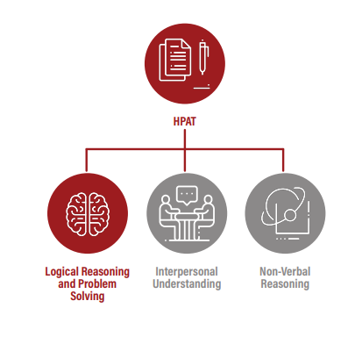

Slide 24
Practical Advice For Students
Start thinking about the HPAT early
Remember: it’s a skills, not knowledge, based test
2. Schedule in regular practice
Distributed practice is the key to HPAT success

Slide 25
How MedEntry Can Help

Slide 26
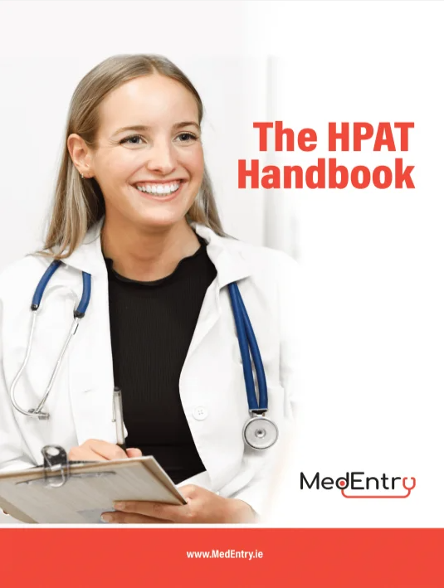
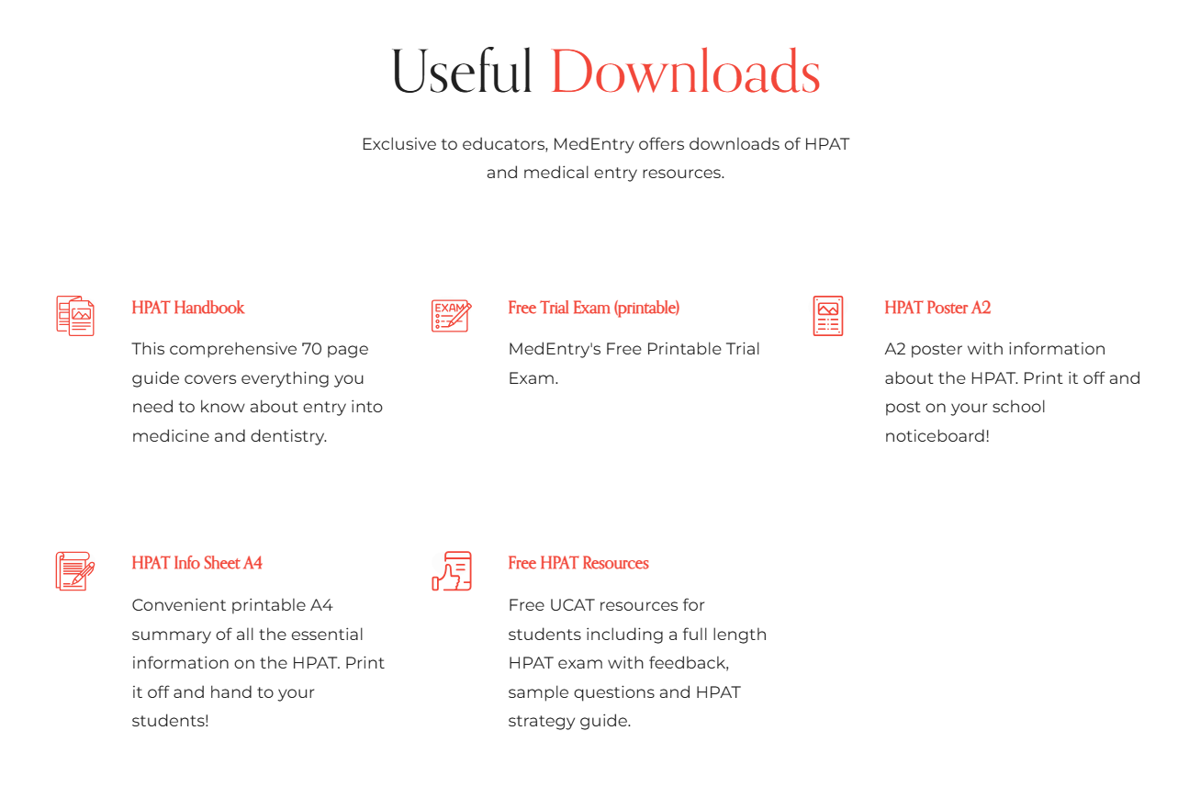
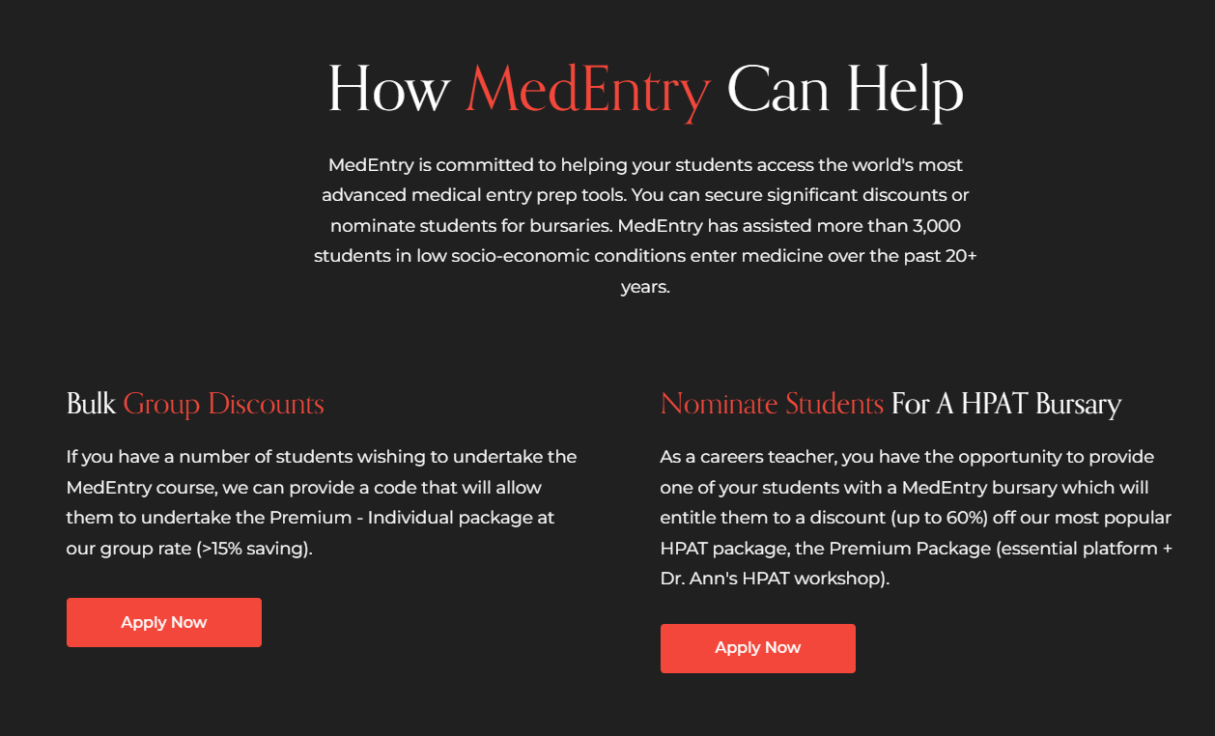
Free Getting into Medicine Help
https://www.medentry-hpat.ie/teachers
Notes:
https://www.medentry-hpat.ie/teachers

Slide 27
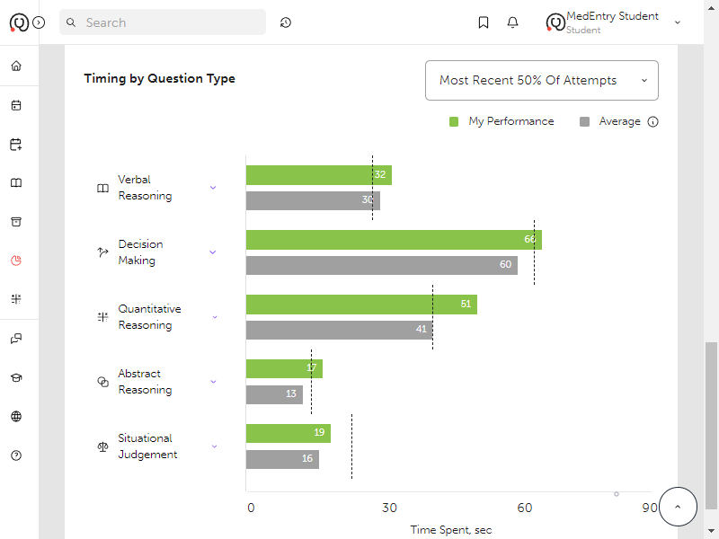
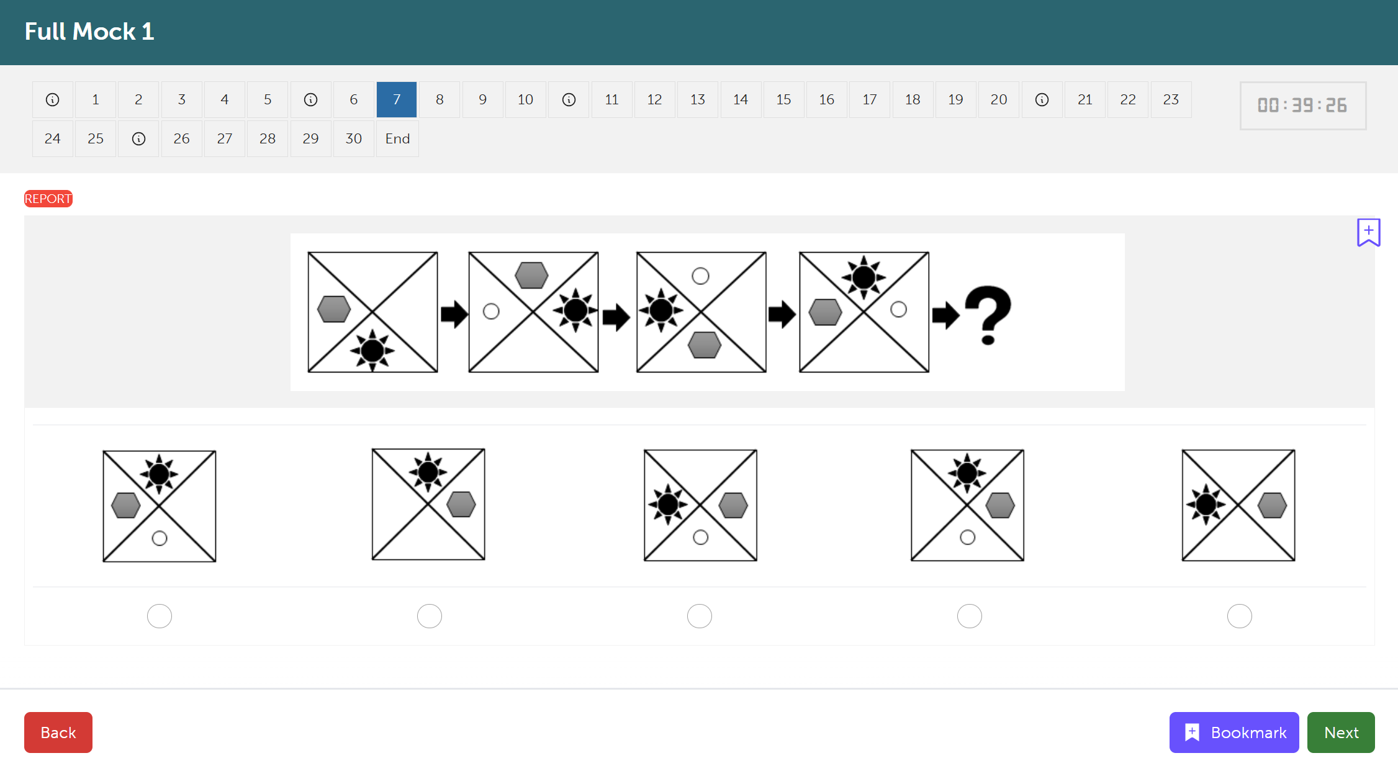
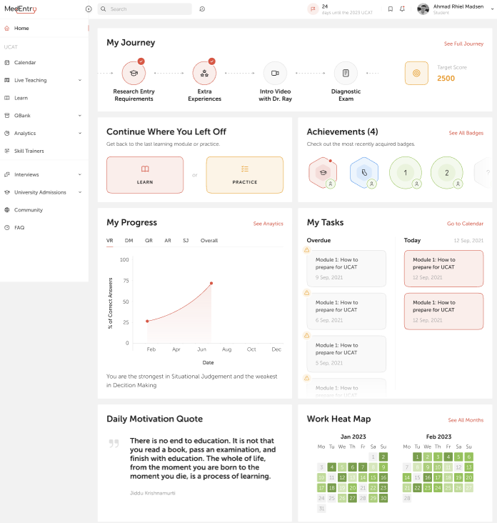
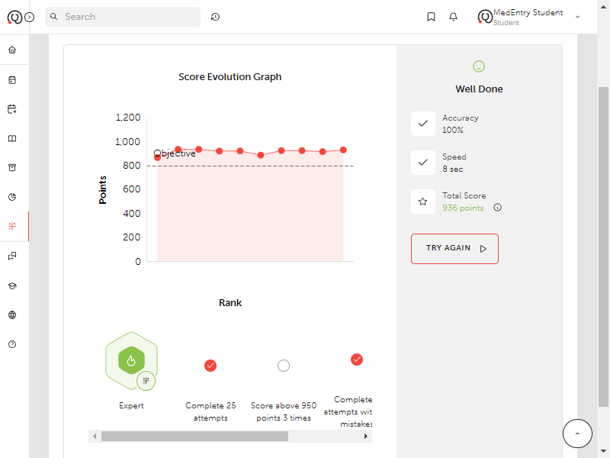
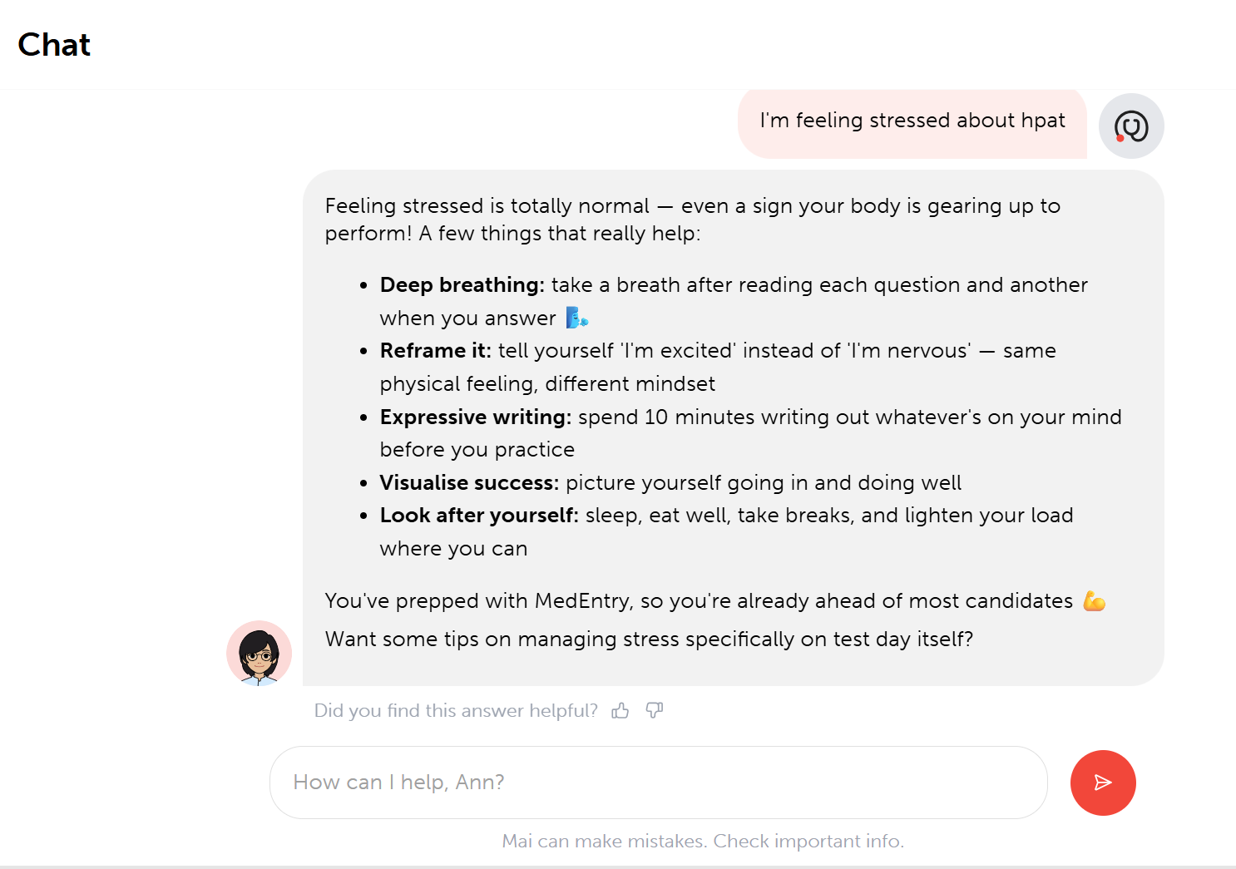
Online Learning Platform

Slide 28
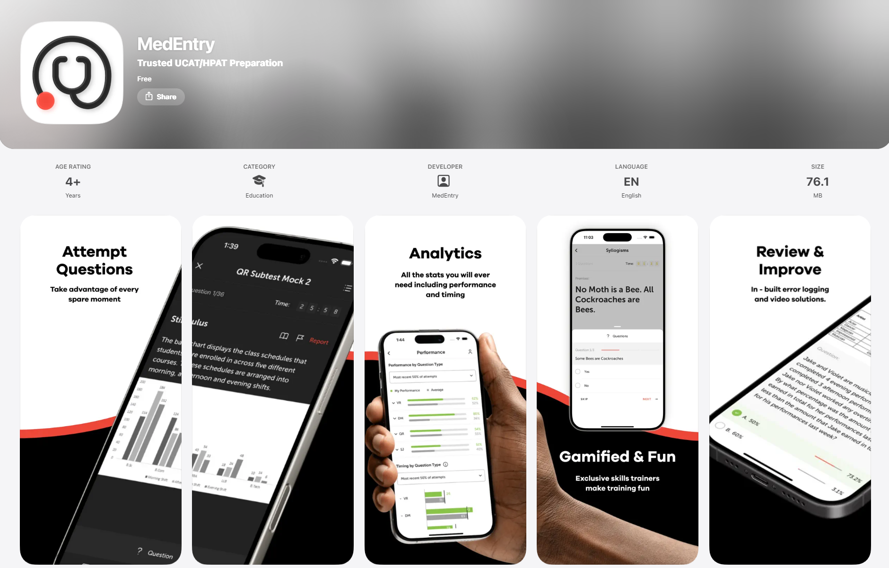
Learning on the Go: Mobile App

Slide 29
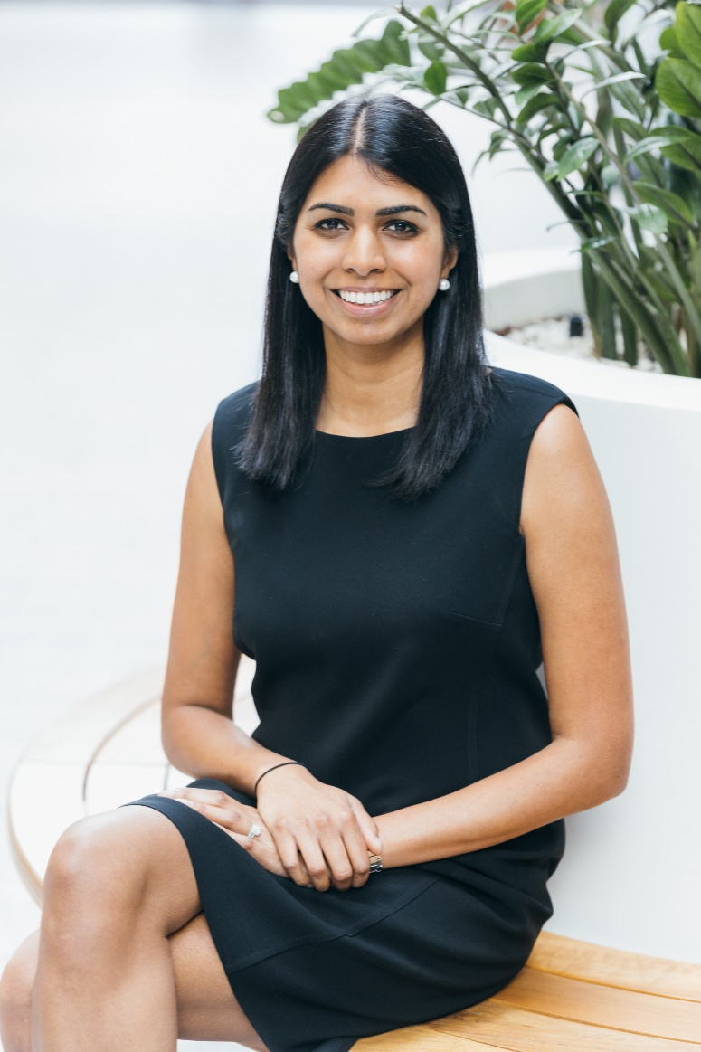
Live teaching
2 day workshops with Dr Ann
Weekly grinds
Personal tutoring

Slide 30

Questions?

